Slide 1
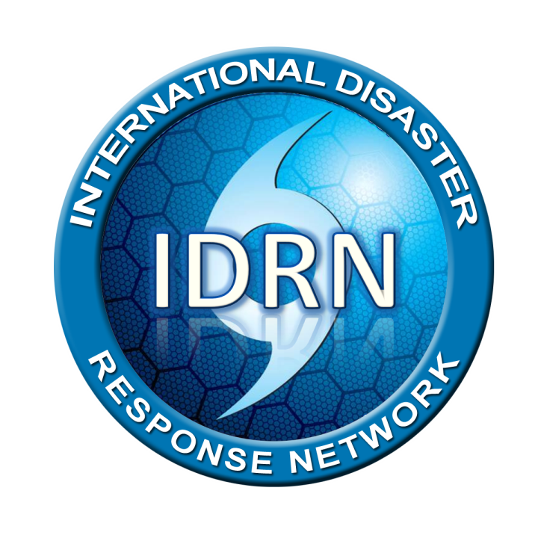

Slide 2

IDRN 1100
Anaheim, CA USA
Mar. 31~Apr. 2, 2015

Slide 3

재난 준비
왜 이 자리에 참석하였나?
소개
왜 이 자리에 참석하였나?
  당신이 기대하는 것은?
  당신이 경험했던 것은?
  당신이 두려워 하는 것들은?
팀을 만들고 팀 이름을 선택하세요.
Notes:
The first bullet is key: if a responder puts himself in danger – he/she is likely to become part of the problem and NOT part of the solution.

Slide 4
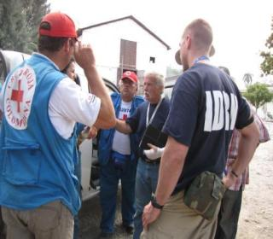
IDRN 코스
IDRN 1100 – CBDP
지역 중심 재난 준비
IDRN 1300 – CBDR
지역 중심 재난 구조

Slide 5
목 표
재난의 원인과 영향을 이해한다.
가족 단위 준비계획을 수립하는 방법을 이해한다.
생존을 위한 기본적인 사항을 이해한다.
재난구조를 위한 기본적인 사항을 이해한다.
개인이나 가족단위로 재난 준비를 완료한다.

Slide 6
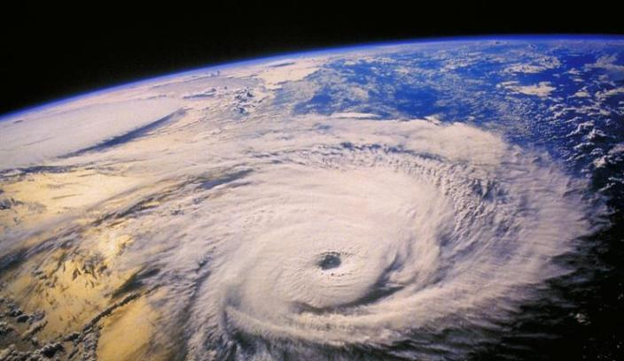
왜 준비해야 하는가?

Slide 7
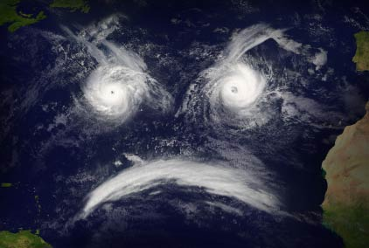
지난 10년 간
“제네바 재난역학연구센터가 발표한 수치에 따르면, 지난 10년 간 3,852 건의 재난 가운데 78만 명의 사망자와 20억 명 이상의 환자, 그리고 9천6백억 불 이상의 재산 손실이 발생하였다.”

Slide 8
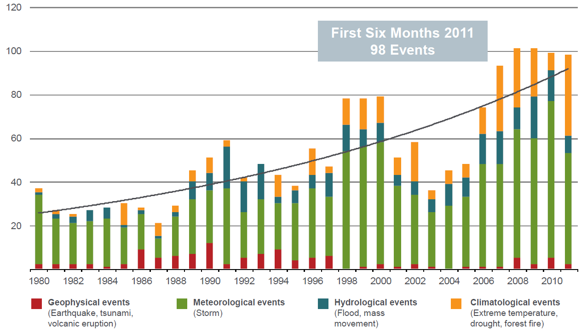

Slide 9
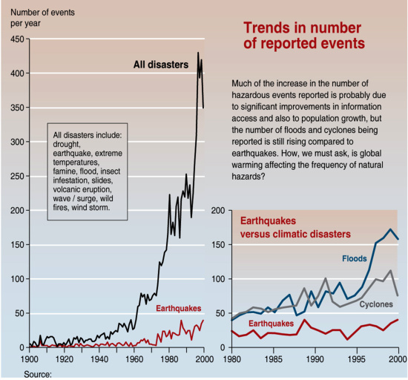
Some Natural Disasters are Increasing

Slide 10
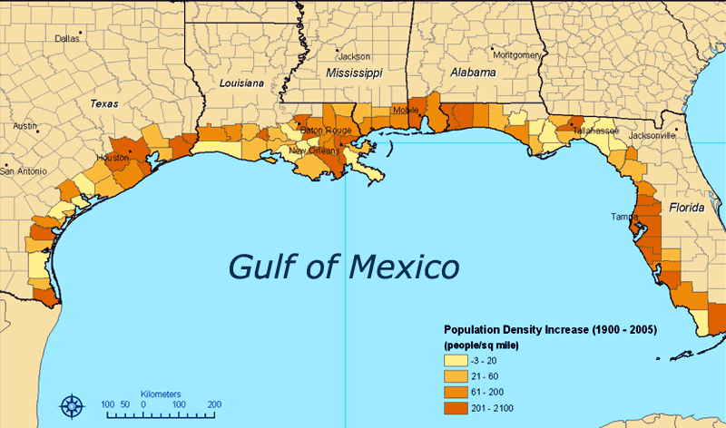

Slide 11
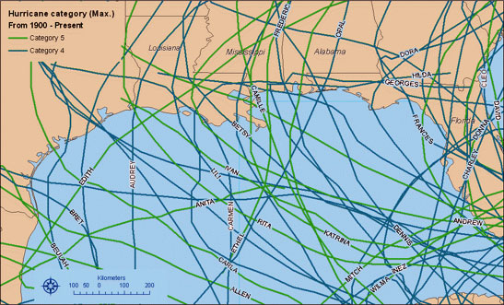

Slide 12
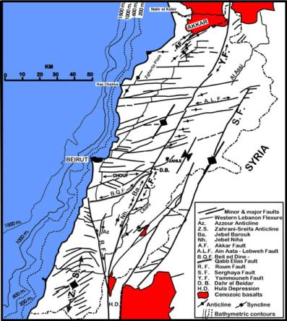
그런 일이 내게 일어날 리가..
아래의 사건들을 생각해 본다면….
  베이루트 – 551 AD
  아이티 - 2010
  뉴 마드리드 – 1800s
  후쿠시마 – 2011
  콜로라도-2012,2013

Slide 13
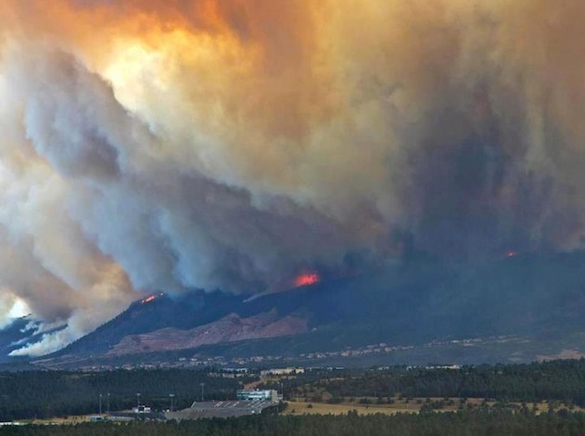

Slide 14
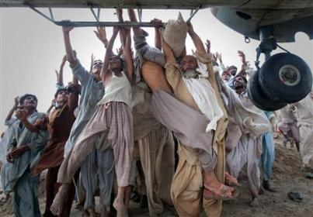
도움은 언제 오는가?
Hours?
Days?
Weeks?
Never?
정부의 능력은 어떤 것일까?
어떤 요소로 구성되었으며, 그 것으로 충분할까?

Slide 15
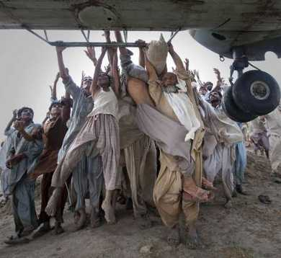
도움을 기대하지 말라
당신의 생존은 정부가 아니라
당신의 준비에 달려있다
Notes:
The amount of time available to evacuate a home or community depends on the hazard. Sometimes, there are days to prepare: for example, hurricanes can generally be detected early. However, in sudden emergencies, such as hazardous materials spills, there may be only moments to leave the area. This means families must prepare now, because when it is time to leave home, it may be too late to collect even the most basic necessities. It also helps to consider in advance where you would go when advised to evacuate ⎯ to a designated public shelter or to relatives or friends outside the disaster area. The supplies you need should be readily available, along with a checklist to ensure that you have everything.
Evacuation periods can last for hours, several days, or even longer after a major disaster. For part, or all, of this time, citizens may be responsible for their own food, clothing, and other emergency supplies.
For some emergencies—such as winter storms or a hazardous material spill— residents may need to take shelter in their homes. Regardless of whether a safe response means evacuating or seeking shelter at home, residents should be prepared to take care of their household’s needs without outside help for a minimum of 3 days. Once a disaster is in progress, there will be no time to shop or search for supplies. But if people have gathered supplies in advance, families can endure an evacuation or home confinement. Disaster supply kits should contain the supplies listed below. The supplies should be stored in an easy-to-carry container such as a duffel bag, backpack, or covered container.

Slide 16
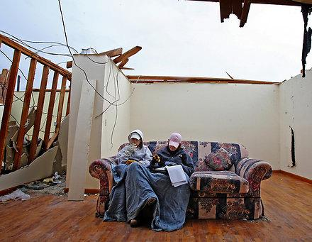
나는 준비되었나?
다음 재난은 언제 발생할까? 얼마나 큰 규모일까?
내 가족들은 재난에 취약한 상태인가?
오늘 심각한 재난이 발생하면 나는 살아남을 수 있을까?
Notes:
You are encouraged to not let people give simple answers to these questions. They are difficult questions and deserve thoughtful answers. Always find the point your trainees are attempting to make and accept that it is important to them. Never embarrass your trainees or they will not have a positive learning experience. If the answer is not what you were looking for to answer these questions then guide them to a better answer. Example:
Questions 2: When will the next one happen?
Most people immediately will say you can’t predict an earthquake or hurricane and they are correct. But what about a terrorist event is it possible to predict those. The answer is sometimes and that should lead to a later discussion of Situational Awareness. Tie it together for later use in your training event.

Slide 17

준비하라!
Notes:
Ask this question and encourage trainees to dig deep for answers. Do not accept superficial answers such as “my friends were coming and I decided to come also”.
It is VERY important for participants to identify their motivation for disaster preparation.
Are attendees attending training because of their specific disaster fears and preparation requirements?
Do trainees desire to become a trained, competent disaster responder?
Is it a combination of both 1 and 2?
What people do before a disaster can make a dramatic difference in their ability to cope with and recover from a disaster, as well as their ability to protect other household members and family possessions from avoidable losses.
A plan will allow you to: be ready to evacuate your homes, survive a period of confinement to the home, make stays in public shelters more comfortable, and take care of basic medical needs. They can even save each others’ lives.

Slide 18
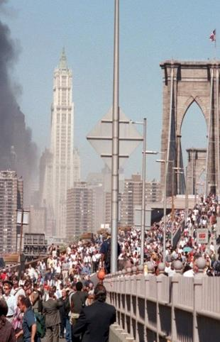
준비하라!
준비 과정
위험 인지
  위험 요소를 인지하라
계획 수립
  개인 및 가족 단위로 재난상황에서 생존하기 위한 구체적인 계획을 수립하라
장비 확보
  생존을 위한 물품 및 장비를 확보하라

Slide 19

위험 인지

Slide 20
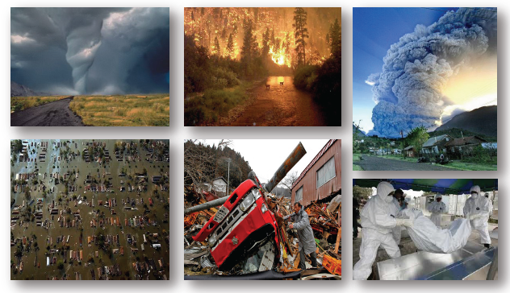
재난의 정의는?

Slide 21
재난의 정의는?
“재난은 발생지역의 구조 능력 한계를 벗어난 비일상적인 사건으로, 발생지역의 인명이나 재산 보존 및 사회, 경제, 정치적 안정성 유지가 불가능하게 된다.” (FEMA)
“재난은 발생지역의 기능을 심각하게 저해하며, 해당지역의 자원만으로 대처할 수 있는 능력을 뛰어넘어 광범위한 인적, 물적, 환경적 손실을 유발한다.” (UNDP)

Slide 22
재난 유형
자연재난
홍수
토네이도/허리케인
지진화산
산사태/쓰나미
들불
기술재난
화학
핵
생물학
화재
인프라
복합재난
이주
전쟁
테러
대량학살

Slide 23
자연 재난
수문
지구물리
생물
기상
기후

Slide 24
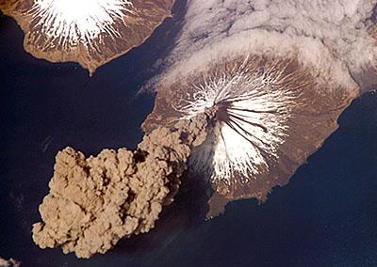
무엇이 위기를 야기하나?
  화산이 무인도에서 폭발한다면….
  지진이 준비가 잘 된 도시에서 발생해서, 사상자가 없고 피해가 경미하다면.
  대규모 난민들이 소규모 지역에 자리 잡는다면…
Notes:
Ask this question and encourage trainees to dig deep for answers. Do not accept superficial answers such as “my friends were coming and I decided to come also”.
It is VERY important for participants to identify their motivation for disaster preparation.
Are attendees attending training because of their specific disaster fears and preparation requirements?
Do trainees desire to become a trained, competent disaster responder?
Is it a combination of both 1 and 2?

Slide 25
영향
“생명을 위협하는 것은 지진이 아니라 건물이다.”
위험
취약성
수용 능력
영향
Notes:
번역 요함

Slide 26
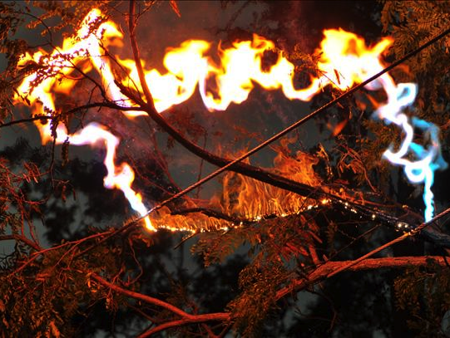
영향
서비스 피해
공공 치안 및 의료 시스템
  응급의료, 경찰서, 소방서, 병원
배관 시스템
  하수 시설, 식수, 가스 등
전기 시설
  태양전지판, 태양열 발전소 제외
통신 시스템
  이동통신, 인터넷, 텔레비전, 라디오, 전화
물류 및 운송
  도로, 철도, 항공, 우편, 연료, 제품 및 식품

Slide 27
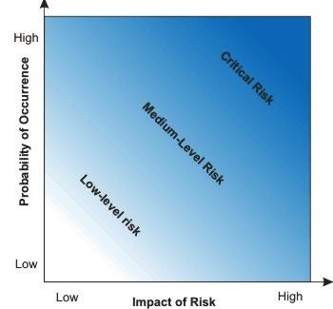
위험 분석
위험 분석
지역사회 내 위험요인 목록을 작성하라
발생가능성 + 영향
가능성과 영향의 합이 클수록 사건의 위험성이 높아진다.

Slide 28
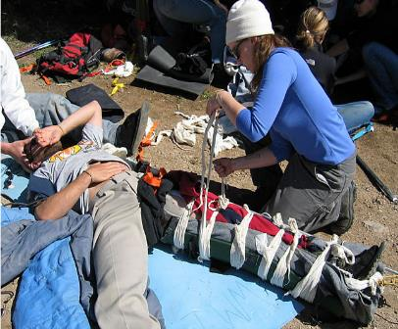
재난 위험 경감
취약성 경감
재난 방지
  전쟁 및 구조적 결함
재난 경감
  조기 경보 시스템/ 건축 규정/ 장애물/ 방파제/ 삼림 벌채
재난 대비
  재난 키트 (Go Bag) / 계획 수립
Notes:
The first bullet is key: if a responder puts himself in danger – he/she is likely to become part of the problem and NOT part of the solution.

Slide 29
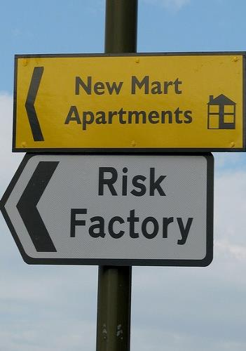
위험 분석
재난 종류 | 발생 가능성 | 영향 | 위험 | 순위
산불
폭설
토네이도
홍수
시민 폭동
지진
테러

Slide 30
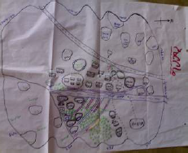
위험 분석
위험요인 매핑
어떤 위험요인이 있는가?
구체적으로 어떤 지역에 피해 가능성이 있는가?
어떤 시설이 피해를 입을 수 있는가?
위험에 가장 취약한 계층은 누구이며 어떤 사람들이 가장 도움을 필요로 할 가능성이 높은가?
사용 가능한 자원은 무엇인가?
해당 자원에 대한 접근 및 관리 권한이 누구에게 있는가?
어떤 자원이 피해를 입을 가능성이 있는가?

Slide 31
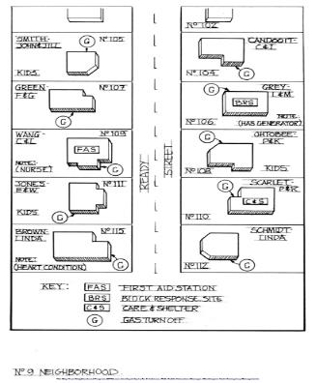
위험 분석
위험요인 분석 방법
지역주민들도 참여할 수 있도록 하라
해당 지역에 대한 마스터플랜을 수립하라 (구글 어스 활용)
  도로
  주택
  시설
  **이웃주민의 이름도 기입하라**

Slide 32
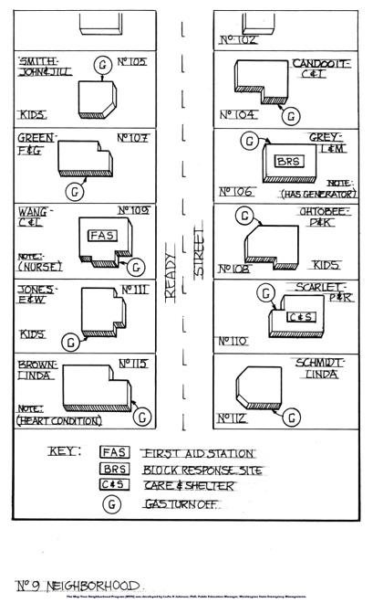
Risk Analysis

Slide 33
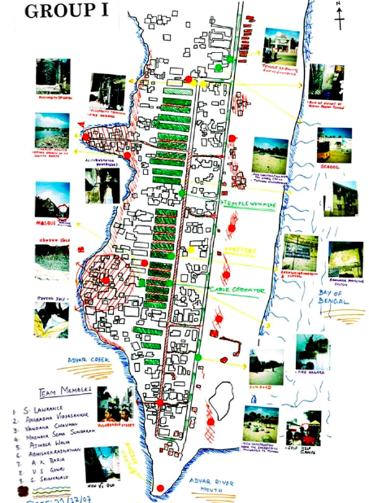
Risk Analysis

Slide 34
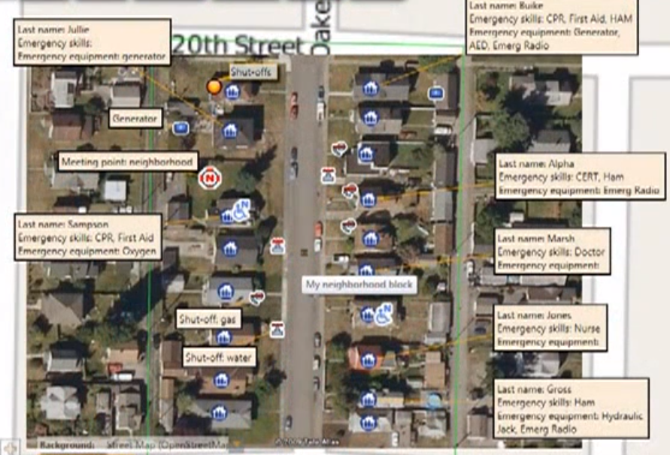
Risk Analysis

Slide 35
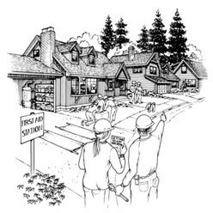
위험 분석
위험요인 매핑 방법
주요 지역 주민과 접촉하라
지도 정보를 검토하라
사진을 촬영하라
위험 노출 지역 및 주민층을 파악하라

Slide 36
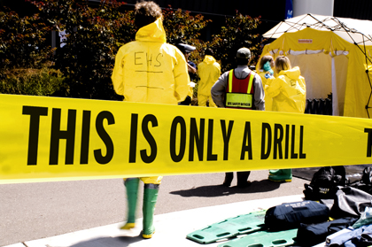
활동 – 위험요인 매핑
당신이 속한 지역의 위험 요인 지도를 만들되, 위험 분석 훈련에서 다루었던 재난 및 위험도가 가장 큰 사건을 활용하라. 다음 사항들이 포함되도록 하라.
피해 가능 지역
피해 가능 주민
활용 가능한 자원, 기술, 장비
주요 인프라시설

Slide 37
위험 인지
비상 경보 시스템
비상 경보 시스템 (EAS)
NOAA 기후 라디오 방송 (NWR)
무선 비상 경보 (WEA)
도시 비상 라디오 채널 (850 AM)
사이렌

Slide 38
계획 수립

Slide 39
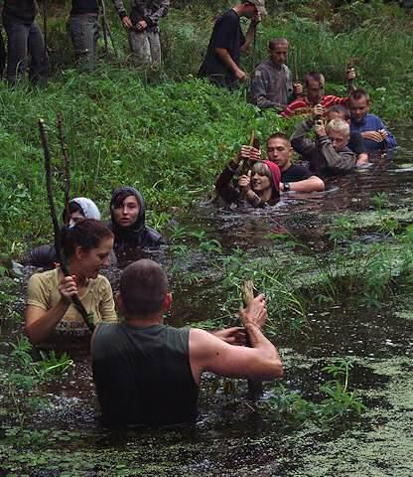
재난에 대한 심리 상태
재난에 대한 태도
10-80-10 이론
  10% - 이성적인
  80% - 얼어붙은
  10% - 위험한
Notes:
10 percent of us will handle a crisis in a relatively calm and rational state of mind. Under duress these 10% pull themselves together quickly. They assess situations clearly. Their decision making is sharp and focused. They’re able to develop priorities, make plans, and take appropriate action. They tend to keep emotions in check so they can think and solve problems. Psychologists call this process “slitting” and it is common among people who keep their cool under the greatest stress.
Large majority of us fall into the 80%. IN a crisis most of us will be “stunned and bewildered. We’ll find that our “reasoning is significantly impaired and that thinking is difficult.” We’ll behave in “a reflexive, almost automatic or mechanical manner”. The 80% will feel lethargic and numb. We’ll sweat. We’ll feel sick. Our hearts will race and we’re experiencing “perceptual narrowing” or so-called tunnel vision. We’ll stare straight ahead. We will not hear people around us. We will lose sense and sight of what is going on around us. IN short most of us will turn into status in the first moments of a crisis. It’s okay – it’s not necessarily fatal – and it doesn’t last forever. The key is to recover quickly from brainlock or analysis paralysis, shake off the shock, and figure out what to do.
The last group – the final 10% is the one you want to avoid in an emergency or crisis. The members of the third band do the wrong thing. They behave inappropriately and often counterproductively. They make the situation worse. They’re the ones who lose control of themselves and freak out and cannot regain control of themselves.
Which are you in:
Actively surviving 10%
Statuesque 80%
Dangerous 10%
IN reality it is very hard to know what you will do. Even highly trained firefighters, police, medical personnel, and military sometimes freeze while children with no training glide through any situation.
How do you break out of the Statuesque 80%?

Slide 40
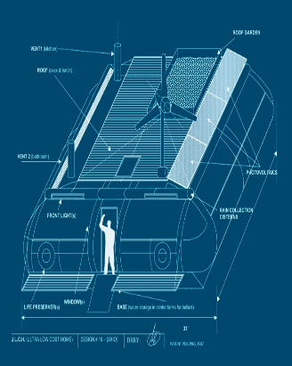
기본 단계
집 내부의 위험요인 줄이기
모든 전기 패널의 위치를 파악하고 라벨을 붙이라
가스관 잠금 장치의 위치를 파악하고 라벨을 붙이라
오래된 물건들을 정리하라
태풍 시 집에 피해를 끼칠 수 있는 나뭇가지나 관목을 정돈하라
무겁거나 깨지기 쉬운 물품들은 아래쪽에 보관하라
손상된 전기 플러그, 코드 및 콘센트를 수리하라
유연한 관이음새를 설치하라
가연성 및 위험 한 물질이나 액체는 전기 제품으로 멀리 떨어진 안전한 곳에 보관하라
집 내의 출구, 소화기, 비상약품, 전기 및 설비 차단 시설이 있는 곳을 지도로 표시하라

Slide 41
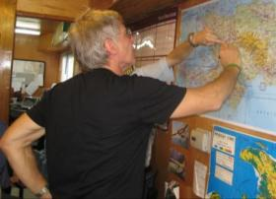
가족 단위 대비 계획
재난 위험 분석 실시
각 위험에 대한 대응책 마련
비상시 집결 지점 마련
제3 지점 마련
역할 및 책임 할당
집 내부의 위험 요소
간단한 구조 기술 훈련
재난 키트 및 필수 물품 구비
계획 연습
Notes:
(번역 요함)These will all be outlined in the following slides.

Slide 42
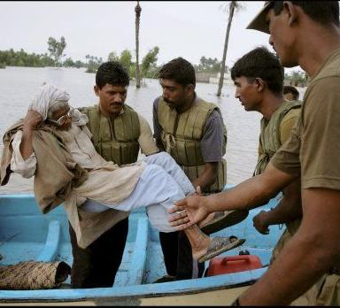
가족 단위 대비 계획
계획 시 고려대상
  청각 장애인
  거동이 불편한 사람
  미혼모 혹은 미혼부
  특별한 음식 섭취 요건이 있는 사람
  유아 및 아동
  *네트워크 지원 및 경보
Notes:
If you or someone close to you has a disability or a special need, you may have to
take additional steps to protect yourself and your family in an emergency
Hearing impaired May need to make special arrangements to receive
warnings.
Mobility impaired May need special assistance to get to a shelter.
Single working parent
May need help to plan for disasters and emergencies.
May need assistance planning for and responding to
emergencies. Community and cultural groups may be
able to help keep people informed.
People without vehicles
May need to make arrangements for transportation.
People with special dietary needs
Should take special precautions to have an adequate
emergency food supply.
Planning for Special Needs
If you have special needs:
• Find out about special assistance that may be available in your community.
Register with the ofﬁce of emergency services or the local ﬁ re department for
assistance so needed help can be provided. Are You Ready?
Basic
Preparedness
• Create a network of neighbors, relatives, friends, and coworkers to aid you
in an emergency. Discuss your needs and make sure everyone knows how to
operate necessary equipment.
• Discuss your needs with your employer.
• If you are mobility impaired and live or work in a high-rise building, have an
escape chair.
• If you live in an apartment building, ask the management to mark accessible
exits clearly and to make arrangements to help you leave the building.
• Keep specialized items ready, including extra wheelchair batteries, oxygen,
catheters, medication, food for service animals, and any other items you
might need.
• Be sure to make provisions for medications that require refrigeration.
• Keep a list of the type and model numbers of the medical devices you require.

Slide 43
EVAC/SIP
Notes:
번역 요함

Slide 44
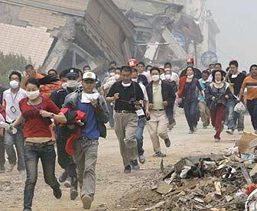
계획을 세워라
대피
  집에서 탈출해야 하나?
  대피 경로는?
  목적지는?
  이동수단은?
  경로분석은?
Notes:
When community evacuations become necessary, local ofﬁcials provide information to the public through the media. In some circumstances, other warning
methods, such as sirens or telephone calls, also are used. Additionally, there may
be circumstances under which you and your family feel threatened or endangered
and you need to leave your home, school, or workplace to avoid these situations.
The amount of time you have to leave will depend on the hazard. If the event is
a weather condition, such as a hurricane that can be monitored, you might have
a day or two to get ready. However, many disasters allow no time for people to
gather even the most basic necessities, which is why planning ahead is essential.
In addition to ﬁnding out about your community’s plan, it is important that you
know what plans are in place for your workplace and your children’s school or day
care center.
1. Ask your employer about workplace policies regarding disasters and emergencies, including understanding how you will be provided emergency and
warning information.
2. Contact your children’s school or day care center to discuss their disaster procedures.
School Emergency Plans
Know your children’s school emergency plan:
• Ask how the school will communicate with families during a crisis.
• Ask if the school stores adequate food, water, and other basic supplies.
• Find out if the school is prepared to shelter-in-place if need be, and where
they plan to go if they must get away.
In cases where schools institute procedures to shelter-in-place, you may not be
permitted to drive to the school to pick up your children. Even if you go to the
school, the doors will likely be locked to keep your children safe. Monitor local
media outlets for announcements about changes in school openings and closings,
and follow the directions of local emergency ofﬁ cials.
For more information on developing emergency preparedness plans for schools,
please log on to the U.S. Department of Education at www.ed.gov/emergencyplan

Slide 45
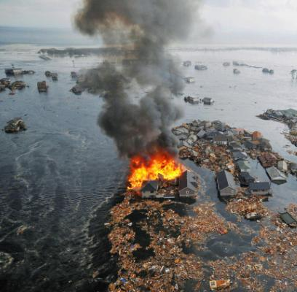
계획을 세워라
출발하기 전
가정에서의 준비
  가스,전기 ,수도 – 차단해야 하나?
  널빤지,모래주머니…등
서류/보험
가족 간의 조율/모임 장소
Notes:
Gas
Natural gas leaks and explosions are responsible for a signiﬁcant number of ﬁ res
following disasters. It is vital that all household members know how to shut off
natural gas.
Because there are different gas shut-off procedures for different gas meter conﬁgurations, it is important to contact your local gas company for guidance on preparation and response regarding gas appliances and gas service to your home.
When you learn the proper shut-off procedure for your meter, share the information with everyone in your household. Be sure not to actually turn off the gas
when practicing the proper gas shut-off procedure.
If you smell gas or hear a blowing or hissing noise, open a window and get everyone out quickly. Turn off the gas, using the outside main valve if you can, and call
the gas company from a neighbor’s home.
Water
Water quickly becomes a precious resource following many disasters. It is vital that
all household members learn how to shut off the water at the main house valve.
• Cracked lines may pollute the water supply to your house. It is wise to shut
off your water until you hear from authorities that it is safe for drinking.
• The effects of gravity may drain the water in your hot water heater and toilet
tanks unless you trap it in your house by shutting off the main house valve
(not the street valve in the cement box at the curb—this valve is extremely
difﬁcult to turn and requires a special tool).
Preparing to Shut Off Water
• Locate the shut-off valve for the water line that enters your house. It may
look like this:
• Make sure this valve can be completely shut off. Your valve may be rusted
open, or it may only partially close. Replace it if necessary.
CAUTION – If you turn off the gas for any reason, a qualiﬁed
professional must turn it back on. NEVER attempt to turn the
gas back on yourself.
Preparedness
• Label this valve with a tag for easy identiﬁcation, and make sure all household
members know where it is located.
Electricity
Electrical sparks have the potential of igniting natural gas if it is leaking. It is wise
to teach all responsible household members where and how to shut off the electricity.
Preparing to Shut Off Electricity
• Locate your electricity circuit box.
• Teach all responsible household members how to shut off the electricity to
the entire house.
Obtain property, health, and life insurance if you do not have them. Review existing policies for the amount and extent of coverage to ensure that what you have in
place is what is required for you and your family for all possible hazards.
Inventory Home Possessions
Make a record of your personal property, for insurance purposes. Take photos or a
video of the interior and exterior of your home. Include personal belongings in
your inventory.
You may also want to download the free Household and Personal Property Inventory Book from the University of Illinois at www.ag.uiuc.edu/~vista/abstracts/
ahouseinv.html to help you record your possessions.
Important Documents
Store important documents such as insurance policies, deeds, property records,
and other important papers in a safe place, such as a safety deposit box away from
your home. Make copies of important documents for your disaster supplies kit.
(Information about the disaster supplies kit is covered later.)

Slide 46
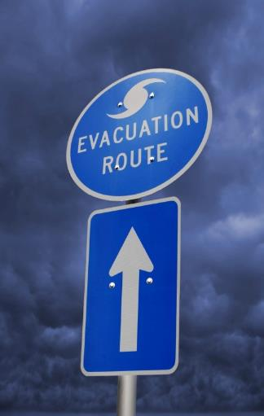
대피
탈출
미리 가족끼리 다시 모일 지점을 정하라
차량이 없을 시 다른 탈출 수단 계획을 세우라
언제나 차량의 연료를 반 이상 채우라
탈출이 예상될 시 연료를 가득 채우라
하나 이상의 탈출 경로를 마련하라 (제2, 제3 경로)
매몰된 전기 배선이나 손상된 도로 및 다리를 주의하라
메시지를 남겨놓으라

Slide 47
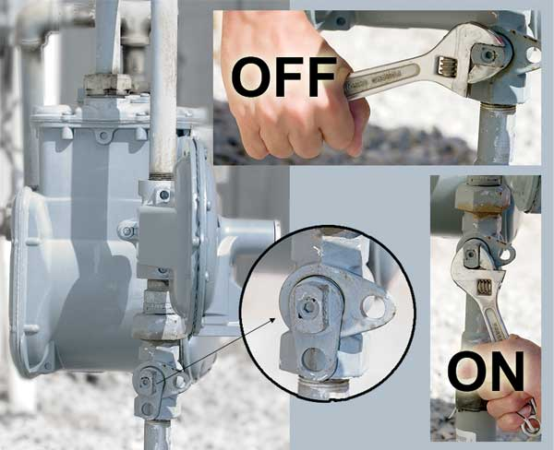

Slide 48
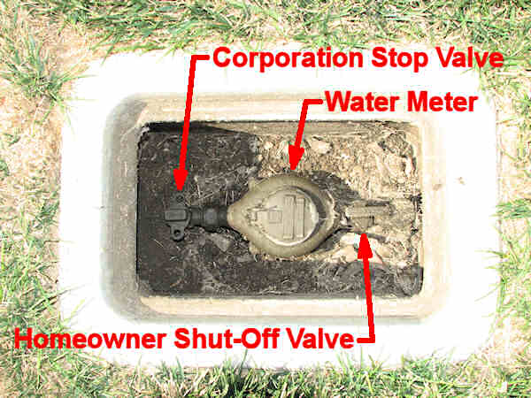

Slide 49
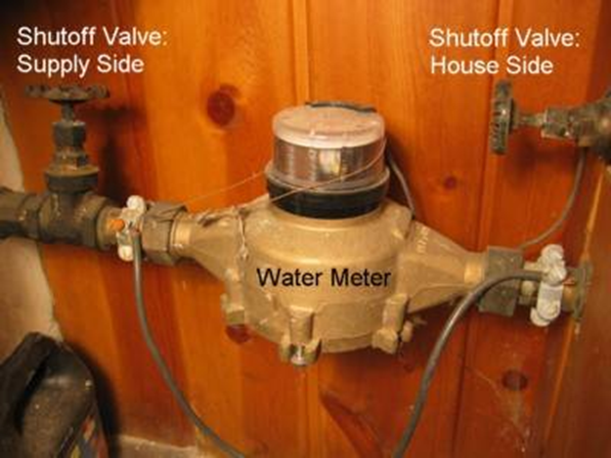

Slide 50
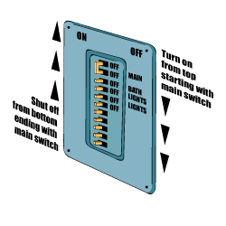

Slide 51
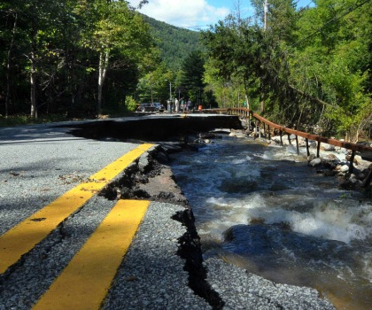
탈출
경로 분석
이용 가능한 탈출 경로는 몇 가지 인가?
각 탈출 경로의 위험 요소가 있는가?
각 경로를 이용하는 데 소요되는 연료 및 시간은 얼마인가?
가족구성원들을 위해 지도를 작성하라
각기 다른 경로를 각기 다른 색깔로 표시하라
재난 종류, 발생 시각, 계절 등에 따라 경로를 달리하라
교통 여건을 고려하라
Notes:
When community evacuations become necessary, local ofﬁcials provide information to the public through the media. In some circumstances, other warning
methods, such as sirens or telephone calls, also are used. Additionally, there may
be circumstances under which you and your family feel threatened or endangered
and you need to leave your home, school, or workplace to avoid these situations.
The amount of time you have to leave will depend on the hazard. If the event is
a weather condition, such as a hurricane that can be monitored, you might have
a day or two to get ready. However, many disasters allow no time for people to
gather even the most basic necessities, which is why planning ahead is essential.
In addition to ﬁnding out about your community’s plan, it is important that you
know what plans are in place for your workplace and your children’s school or day
care center.
1. Ask your employer about workplace policies regarding disasters and emergencies, including understanding how you will be provided emergency and
warning information.
2. Contact your children’s school or day care center to discuss their disaster procedures.
School Emergency Plans
Know your children’s school emergency plan:
• Ask how the school will communicate with families during a crisis.
• Ask if the school stores adequate food, water, and other basic supplies.
• Find out if the school is prepared to shelter-in-place if need be, and where
they plan to go if they must get away.
In cases where schools institute procedures to shelter-in-place, you may not be
permitted to drive to the school to pick up your children. Even if you go to the
school, the doors will likely be locked to keep your children safe. Monitor local
media outlets for announcements about changes in school openings and closings,
and follow the directions of local emergency ofﬁ cials.
For more information on developing emergency preparedness plans for schools,
please log on to the U.S. Department of Education at www.ed.gov/emergencyplan

Slide 52
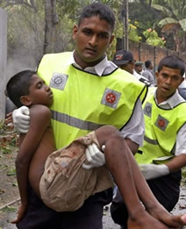
응급 처치
응급 처치 훈련
  기본 응급 처치
  심폐 소생술
  응급 처치 훈련 소요 시간 (40시간)
  야생 응급 처치
  재난 분류
  아동 및 영아 대상 심폐소생술
  AED 과정

Slide 53
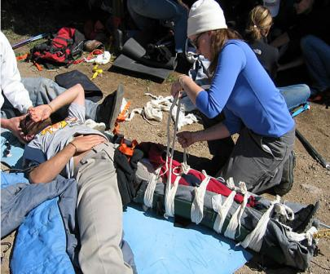
계획 수립
응급처치
현장 안전: 절대 스스로를 위험 속에 내던지면 안 된다
  현장 안전
  체액
구조대원은 필수적이다.
재난 부상자 분류
Notes:
The first bullet is key: if a responder puts himself in danger – he/she is likely to become part of the problem and NOT part of the solution.

Slide 54
EMT Dave’s Recommended Disaster First Aid Kit
• The Disaster First Aid Handbook
• Triage Tags or Tapes / marking pens
• Latex or vinyl gloves, 20 to 30 pairs
• Cloth advesive tapes 1” and 2” wide (2or 3 rolls)
• Plastic advesive tapes 1” and 2” wide (2or 3 rolls)
• Large & Medium sterile gauze pads 4x4 and 8x10
• Extra-Large band-aids 2”x4” or larger
• Quick Clot 3 packages
• Israeli Pressure Dressing
• Large packages (100 non-sterile 4"x4”gauze) (2 or 3 pkgs)
• Roller bandages Kling /Kerlix, or make your own (12 to 25)
• Triangle “cravat” slings, or make your own (several)
• Lots of extra-large safety pins
• Mild disinfectant (“Green Soap” or Betadine scrub)
• Hydrogen Peroxide (to use, dilute with water 50/50)
• Antibiotic ointment (Polysporin, Bacitracin)
• Sterile water or sterile Normal Saline
• Large waterproof Magic Marker
• First Report & Second Report forms (in the book)
• Small tablet or clipboard and pens
• Plastic baggies and heavy garbage bags
• Plastic sheeting ground cover 12x25 ft roll
• Mylar “space blankets” (6-12 or more)
• Clothesline-type rope or sash-cord
• “Duck” Tape (good for everything)
• Blunt-ended or “EMT” scissors 2 or 3 pairs
• Kitchen rubber gloves for general mess
• Pocket knife or folding lock-blade knife
• Consider a clean plastic spray or squirt bottle
• Keep 2 weeks supply of needed prescription medications you or your family usually take. If Diabetic include medicine & snack foods for them.
• Aspirin for FEVER/HEART ISSUES
• Anti-Diarrhea medicine
• Clean water
• CPR Mask
• Instant Cold Compress
• Super Glue

Slide 55
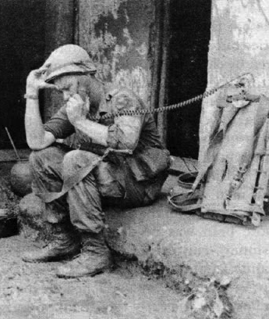
의사소통 계획
가족단위 의사소통
  선불 전화카드
  사진
  연락망
  권한 분배
  집결지
  제3 집결장소
  장소를 표시하라
Notes:
(번역 요함) another. Think about how you will communicate in different situations.
Complete a contact card for each family member. Have family members keep these cards handy in a wallet, purse, backpack, etc. You may want to send one to school with each child to keep on file. Pick a friend or relative who lives out-of-state for household members to notify they are safe.
It is essential for household members to develop a plan for reuniting after a disaster. To prepare for a fire in the home, the family should identify a neighborhood rendezvous point located a safe distance from the house. If household members meet at the same spot, firefighters do not unnecessarily risk their lives trying to rescue someone who is
already safe. This place must be designated in advance. All family members must be directed to evacuate to this designated location in the event of a fire and not to go back into a burning building.
For an emergency that occurs when family members are not at the same location, an out-of- state friend or relative should be asked
to be the “family contact.” Even when local telephone service is disrupted, long distance service often works. After a disaster, separated family members should call the family contact to let him or her know where they are. It is important to make sure everyone knows the contact’s phone number.
It is also wise to know what disaster plans have been made by the children’s school or day care center and where children will be sent if they are in school when an evacuation is announced. Family members should also be aware of disaster plans for places where family members work. Knowing these plans can help them find each other more easily. In case parents should become separated from their children during a disaster, they may wish to consult the doctor in advance and file a Medical Release Form to ensure that any injuries sustained by the children in a disaster would be treated promptly.

Slide 56
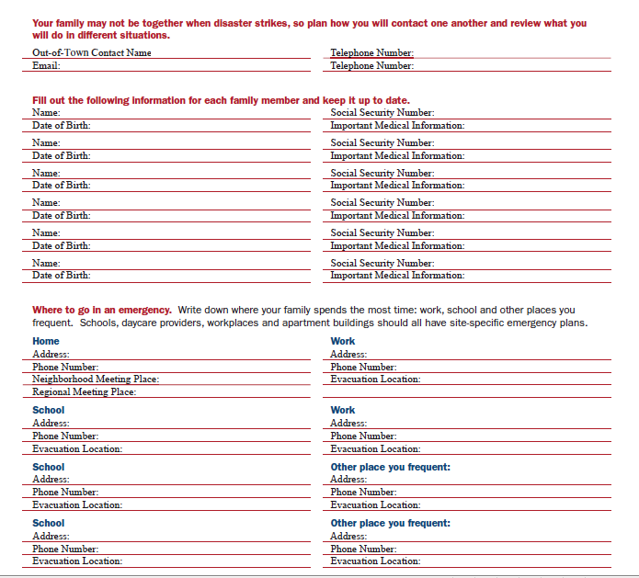
Notes:
Your family may not be together when disaster strikes, so plan how you will con- tact one another. Think about how you will communicate in different situations.
Complete a contact card for each family member. Have family members keep these cards handy in a wallet, purse, backpack, etc. You may want to send one to school with each child to keep on file. Pick a friend or relative who lives out-of-state for household members to notify they are safe.
It is essential for household members to develop a plan for reuniting after a disaster. To prepare for a fire in the home, the family should identify a neighborhood rendezvous point located a safe distance from the house. If household members meet at the same spot, firefighters do not unnecessarily risk their lives trying to rescue someone who is
already safe. This place must be designated in advance. All family members must be directed to evacuate to this designated location in the event of a fire and not to go back into a burning building.
For an emergency that occurs when family members are not at the same location, an out-of- state friend or relative should be asked
to be the “family contact.” Even when local telephone service is disrupted, long distance service often works. After a disaster, separated family members should call the family contact to let him or her know where they are. It is important to make sure everyone knows the contact’s phone number.
It is also wise to know what disaster plans have been made by the children’s school or day care center and where children will be sent if they are in school when an evacuation is announced. Family members should also be aware of disaster plans for places where family members work. Knowing these plans can help them find each other more easily. In case parents should become separated from their children during a disaster, they may wish to consult the doctor in advance and file a Medical Release Form to ensure that any injuries sustained by the children in a disaster would be treated promptly.
번역 안해도 되요.

Slide 57
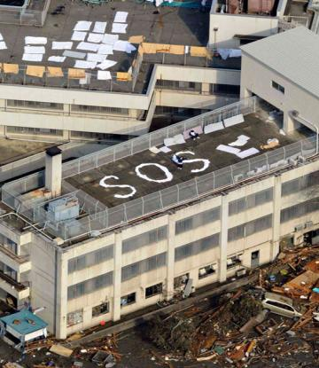
환경에 적응하여 생존하기
연락을 유지하라
라디오:
  아마추어 무선통신
  포켓용
  크랭크 라디오(Crank Radio)
핸드폰/문자
비 전자 식
  신호탄/후레쉬
  호각
  거울
  연기
  글로 쓰기 (SOS를 바위에)
Notes:
Cell phone services quickly become inundated and overwhelmed. It is nearly impossible to place a call during a disaster, even if the infrastructure is intact.
Amateur Radio does not require third parties – encourage getting licensed
Satellite Phones are convenient but expensive – they too can be overwhelmed
Text will sometimes go through when calls will not

Slide 58
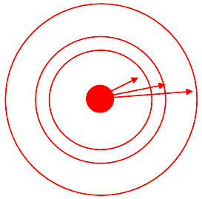
의사소통 계획
가족단위 의사소통
    집결지
    집 단위 – 100m 떨어진 곳
    마을 단위– 5-10 마일 떨어진 곳
    지역 단위– 50-75 마일 떨어진 곳
    SHTF – x > 180 마일 떨어진 곳
    재난 유형에 따라 각기 다른 지점
    ****중복 가능****
Notes:
Your family may not be together when disaster strikes, so plan how you will con- tact one another. Think about how you will communicate in different situations.
Complete a contact card for each family member. Have family members keep these cards handy in a wallet, purse, backpack, etc. You may want to send one to school with each child to keep on file. Pick a friend or relative who lives out-of-state for household members to notify they are safe.
It is essential for household members to develop a plan for reuniting after a disaster. To prepare for a fire in the home, the family should identify a neighborhood rendezvous point located a safe distance from the house. If household members meet at the same spot, firefighters do not unnecessarily risk their lives trying to rescue someone who is
already safe. This place must be designated in advance. All family members must be directed to evacuate to this designated location in the event of a fire and not to go back into a burning building.
For an emergency that occurs when family members are not at the same location, an out-of- state friend or relative should be asked
to be the “family contact.” Even when local telephone service is disrupted, long distance service often works. After a disaster, separated family members should call the family contact to let him or her know where they are. It is important to make sure everyone knows the contact’s phone number.
It is also wise to know what disaster plans have been made by the children’s school or day care center and where children will be sent if they are in school when an evacuation is announced. Family members should also be aware of disaster plans for places where family members work. Knowing these plans can help them find each other more easily. In case parents should become separated from their children during a disaster, they may wish to consult the doctor in advance and file a Medical Release Form to ensure that any injuries sustained by the children in a disaster would be treated promptly.

Slide 59
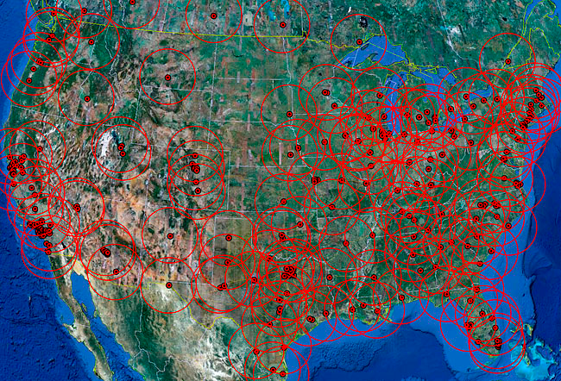
Notes:
While determining an ideal location for a survival retreat or bug-out-location, a location that perhaps you will use as a vacation spot / insurance policy, or maybe a location where you will live full time, you should consider the distance from a dense population area or city. In the event of a terrible disaster, there will be hordes of people trying to escape the city centers which will have become very dangerous from the lack of working infrastructure, food, water, and fuel.
Determine how far the roving hordes will get during their desperate escape from the city
The average fuel economy (miles per gallon) of a vehicle varies of course, depending on factors including vehicle and engine size, its vintage, and whether city or highway driving. In the U.S. the current 2010 ‘CAFE’ standard for new passenger vehicles is 27.5 mpg and 23.5 mpg for light trucks (GVWR less than 8,500 pounds). Not everyone has a new car. A number of years ago a study was performed that determined 60 percent of vehicles in the U.S. were older than seven years. 10 years ago the standards were 27.5 and 20.7 mpg. For the sake of determining the average fuel economy of all vehicles on the road today, factoring in highway and city mileage, my instinct tells me it may be somewhere around 20 miles per gallon, maybe slightly less. Lets use 20 mpg for this example.
The average fuel tank size of passenger vehicles, SUV’s, and trucks range in size from 10-13 gallons for compact-size, 15-18 gallons for mid-size, 18-20 for full-size, to as high as 30 gallons for large vehicles and trucks. I believe that the average fuel tanks size of all vehicles on the road today is probably about 18 gallons.
Although your vehicle may vary from this average (plug in your own numbers), the average maximum range of all vehicles on the road at any given moment based on a full tank of gas is probably about 360 miles (20 mpg x 18 gallons). Problem is, not everyone has a full tank of gas at all times and in fact, many people don’t add fuel until the tank is fairly low (and many people don’t fill the tank at that point either). Averaging all vehicles on the road, I believe that the amount of fuel in the tank at any one time is probably less than half a tank (I would bet one-third of a tank), but for this exercise lets use half a tank. This then changes the average maximum range of all vehicles on the road at any given time to be about 180 miles.
When the hordes evacuate the cities, at best, on average, most won’t get beyond 180 miles. In fact, the average range will be less than that because most people will leave too late and will be caught in slow traffic. The traffic will quickly become heavy and the highways may even become impassible. Just imagine the scenario of heavy traffic, then factor in the vehicles that begin running out of gas which will further clog the highways. People will be getting off exits in search of fuel, which may not be available at all. If there is no electrical power, the fuel cannot be pumped. Even with power, gas stations will run dry quickly. Most people will not have thought about carrying extra fuel.

Slide 60
비상물품 확보

Slide 61
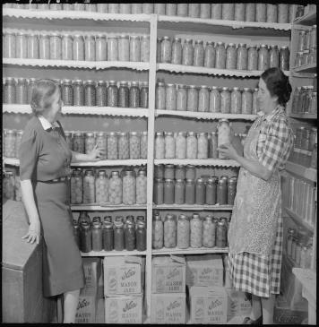
비상물품 확보
물품의 두 가지 유형
    실내 은신처
      집 내부 은신처에서 머무르게 될 경우 필요한 물품
    외부 대피 장소
      집 외부에서 머무르게 될 경우 필요한 물품
Notes:
When community evacuations become necessary, local ofﬁcials provide information to the public through the media. In some circumstances, other warning
methods, such as sirens or telephone calls, also are used. Additionally, there may
be circumstances under which you and your family feel threatened or endangered
and you need to leave your home, school, or workplace to avoid these situations.
The amount of time you have to leave will depend on the hazard. If the event is
a weather condition, such as a hurricane that can be monitored, you might have
a day or two to get ready. However, many disasters allow no time for people to
gather even the most basic necessities, which is why planning ahead is essential.
In addition to ﬁnding out about your community’s plan, it is important that you
know what plans are in place for your workplace and your children’s school or day
care center.
1. Ask your employer about workplace policies regarding disasters and emergencies, including understanding how you will be provided emergency and
warning information.
2. Contact your children’s school or day care center to discuss their disaster procedures.
School Emergency Plans
Know your children’s school emergency plan:
• Ask how the school will communicate with families during a crisis.
• Ask if the school stores adequate food, water, and other basic supplies.
• Find out if the school is prepared to shelter-in-place if need be, and where
they plan to go if they must get away.
In cases where schools institute procedures to shelter-in-place, you may not be
permitted to drive to the school to pick up your children. Even if you go to the
school, the doors will likely be locked to keep your children safe. Monitor local
media outlets for announcements about changes in school openings and closings,
and follow the directions of local emergency ofﬁ cials.
For more information on developing emergency preparedness plans for schools,
please log on to the U.S. Department of Education at www.ed.gov/emergencyplan

Slide 62
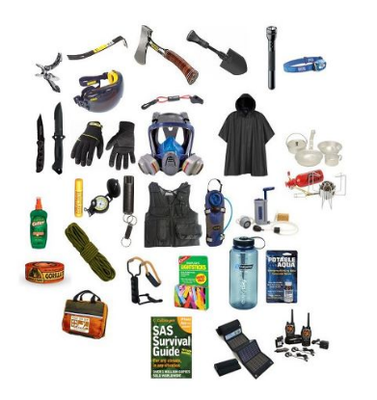
계획 수립
재난키트(Go Bag)
  당신은 빨리 떠나서 생존할 필요가 있다.
  안전하게 되거나 구조될 때까지 며칠이 걸릴 수 있다.
  심각한 재난지역에서 이동 중에 생존하려면 어떤 것들이 필요할까?
    생리적인 필요
    공구/재료/응급용품(aids)
Notes:
When community evacuations become necessary, local ofﬁcials provide information to the public through the media. In some circumstances, other warning
methods, such as sirens or telephone calls, also are used. Additionally, there may
be circumstances under which you and your family feel threatened or endangered
and you need to leave your home, school, or workplace to avoid these situations.
The amount of time you have to leave will depend on the hazard. If the event is
a weather condition, such as a hurricane that can be monitored, you might have
a day or two to get ready. However, many disasters allow no time for people to
gather even the most basic necessities, which is why planning ahead is essential.
In addition to ﬁnding out about your community’s plan, it is important that you
know what plans are in place for your workplace and your children’s school or day
care center.
1. Ask your employer about workplace policies regarding disasters and emergencies, including understanding how you will be provided emergency and
warning information.
2. Contact your children’s school or day care center to discuss their disaster procedures.
School Emergency Plans
Know your children’s school emergency plan:
• Ask how the school will communicate with families during a crisis.
• Ask if the school stores adequate food, water, and other basic supplies.
• Find out if the school is prepared to shelter-in-place if need be, and where
they plan to go if they must get away.
In cases where schools institute procedures to shelter-in-place, you may not be
permitted to drive to the school to pick up your children. Even if you go to the
school, the doors will likely be locked to keep your children safe. Monitor local
media outlets for announcements about changes in school openings and closings,
and follow the directions of local emergency ofﬁ cials.
For more information on developing emergency preparedness plans for schools,
please log on to the U.S. Department of Education at www.ed.gov/emergencyplan

Slide 63
활동 – 재난키트
(Go Bag)
X-18 급 태양표면 폭발이 미국을 강타했다. 전기 공급이 끊겼으며 모든 통신수단이 두절되었고 차량도 시동이 걸리지 않는다. 당신은 가족과 현재 함께 있으며 이 지역을 벗어나 걸어서 근처 언덕으로 대피하기로 결정했다. 이 때 재난 키트에 무엇을 담을 것인가? 단, 무게를 고려하라.

Slide 64
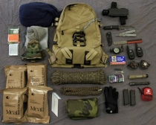
계획 수립
재난키트(Go Bag)
물
부패하지 않는 식품
의류
비옷
슬리핑 백/담요
연락처
헤드램프/토치
파이어 스타터 & 불쏘시게
지도 /GPS/나침반
여분의 의약품
강력 접착 테이프
멀티 툴
호각/거울
현금/신용카드
소독제
낚시줄/바늘/올가미
거울
신호탄
라디오
작업장갑
밧줄 (550 Cord/Para-cord)
구급상자
필터 혹은 정수 꼭지
타프/쉘터
필기구
위생키트
배터리
전화카드
물통
Notes:
You may need to survive on your own after a disaster. This means having your
own food, water, and other supplies in sufﬁcient quantity to last for at least three
days. Local ofﬁcials and relief workers will be on the scene after a disaster, but they
cannot reach everyone immediately. You could get help in hours, or it might take
days.
Basic services such as electricity, gas, water, sewage treatment, and telephones may
be cut off for days, or even a week or longer. Or, you may have to evacuate at a
moment’s notice and take essentials with you. You probably will not have the opportunity to shop or search for the supplies you need.
A disaster supplies kit is a collection of basic items that members of a household
may need in the event of a disaster
The following items are recommended for inclusion in your basic go-bag
kit:
• Three-day supply of non-perishable food.
• Three-day supply of water – one gallon of water per person, per day.
• Portable, battery-powered radio or television and extra batteries.
• Flashlight and extra batteries.
• First aid kit and manual.
• Sanitation and hygiene items (moist towelettes and toilet paper).
• Matches and waterproof container.
• Whistle.
• Extra clothing.
• Kitchen accessories and cooking utensils, including a can opener.
• Photocopies of credit and identiﬁcation cards.
• Cash and coins.
• Special needs items, such as prescription medications, eye glasses, contact lens
solutions, and hearing aid batteries.
• Items for infants, such as formula, diapers, bottles, and paciﬁers.
• Other items to meet your unique family needs.
If you live in a cold climate, you must think about warmth. It is possible that you
will not have heat. Think about your clothing and bedding supplies. Be sure to
include one complete change of clothing and shoes per person, including:
• Jacket or coat.
• Long pants.
• Long sleeve shirt.
• Sturdy shoes.
• Hat, mittens, and scarf.
• Sleeping bag or warm blanket (per person).
Be sure to account for growing children and other family changes. See Appendix B
for a detailed checklist of disaster supplies. You may want to add some of the items
listed to your basic disaster supplies kit depending on the speciﬁc needs of your
family

Slide 65
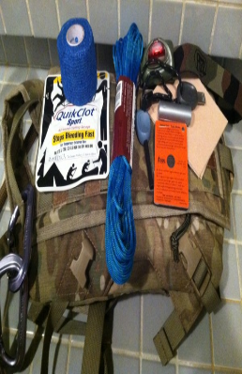
탈출 키트
개인용 키트
다음 물품들을 가방, 지갑 등에 항상 소지하라
  비닐 페이크
  응급 지혈제 및 붕대
  노끈
  경량 비상 식품
  생존 신호 거울
  나침반
  헤드랜턴
  멀티툴
  초콜렛/ 물
  현금
  담요나 망토

Slide 66

서류
여러 곳에 복사본을 보관하라
안전한 하드 드라이브에 스캔본을 저장하라
원본은 화재로부터 안전한 곳에 보관하라
클라우드나 하드 드라이브에 데이터를 백업해 두라
출생 신고서
혼인 신고서
운전면허증
사회 안전 증서 (Social Security cards)
여권
유서
주택 및 건물 소유 증서
물품 목록
보험 증서
예방접족 기록
계좌 및 신용카드 정보
주식 및 채권
비상 연락망

Slide 67

계획 수립
물품
가정
  얼마나 오랫동안 견뎌야 하는가? 3주-6개월
직장
  만일 직장에 있다면? 하루-이틀
차량
  만일 차 안에 갇혀 있다면?1-3일
  *차량에 재난키트(go bag)가 있을 경우
Notes:
A person can have a massive stockpile of supplies at his/her home, but if a disaster or emergency occurs while they are at work or in their car, their home-supplies will be useless.
Just as important as putting your supplies together is maintaining them so they are
safe to use when needed. Here are some tips to keep your supplies ready and in
good condition:
• Keep canned foods in a dry place where the temperature is cool.
• Store boxed food in tightly closed plastic or metal containers to protect from
pests and to extend its shelf life.
• Throw out any canned good that becomes swollen, dented, or corroded.
• Use foods before they go bad, and replace them with fresh supplies.
• Place new items at the back of the storage area and older ones in the front.
• Change stored food and water supplies every six months. Be sure to write the
date you store it on all containers.
• Re-think your needs every year and update your kit as your family needs
change.
• Keep items in airtight plastic bags and put your entire disaster supplies kit in
one or two easy-to-carry containers, such as an unused trashcan, camping
backpack, or duffel bag

Slide 68

계획 수립
물
1인당 4 리터
물의 사용을 증가시키는 것들은?
  신체 활동
  뜨거운 기후
  모유 수유 산모
  환자
  응급의료상황
Notes:
Water:
Your body loses water through normal body processes (sweating, urinating, and defecating). During average daily exertion when the atmospheric temperature is 20 degrees Celsius (C) (68 degrees Fahrenheit), the average adult loses, and therefore requires, 2 to 3 liters of water to replace what is lost daily. Other factors, such as heat exposure, cold exposure, intense
activity, high altitude, burns, or illness, can cause your body to lose more water. You must replace this water.
Dehydration results from inadequate replacement of lost body fluids. It decreases your efficiency and, if injured, increases your susceptibility to
severe shock.
Consider the following results of body fluid loss:
A 5 percent loss of body fluids results in thirst, irritability, nausea, and weakness.
A 10 percent loss results in dizziness, headache, inability to walk, and a tingling sensation in the limbs.
A 15 percent loss results in dim vision, painful urination, swollen tongue, deafness, and a numb feeling in the skin.
A loss greater than 15 percent of body fluids may result in death.
The most common signs and symptoms of dehydration are—
Dark urine with a very strong odor.
Low urine output.
Dark, sunken eyes.
Fatigue.
Emotional instability.
4-2Loss of skin elasticity.
Delayed capillary refill in fingernail beds.
Trench line down center of tongue.
Thirst. - Last on the list because you are already 2% dehydrated by the time you crave fluids.

Slide 69

계획 수립
식수 보관
저장하기 전에 물1리터당 음료 소독약 한 두 방울을 넣어라
저장용기
  식품등급의 플라스틱 사용
  주스나 우유용기 사용금지
  음료수 병은 위생처리 후 사용 가능
6개월 마다 물 저장용기를 교환해 줄 것
재난 발생 이전에 미리 물을 채우라
대체 식수원을 기억해두라
저수 시스템을 고려하라
Notes:
Milk and Juice leave microscopic organic particles that bond to plastic. These particles can quickly contaminate clean water and cause the growth of mold and other harmful micro organisms. It is nearly impossible to completely sterilize a container, so two drops of bleach per gallon is necessary. This will prevent micro-organism growth but will not harm the body. Just to be safe – replace water every 6 months.
How Should I Store Water?
To prepare safest and most reliable emergency supply of water, it is recommended
you purchase commercially bottled water. Keep bottled water in its original container and do not open it until you need to use it.
Observe the expiration or “use by” date.
If you are preparing your own
containers of water
It is recommended you purchase food-grade water storage containers from surplus or camping supplies stores to use for water storage. Before ﬁ lling with water,
thoroughly clean the containers with dishwashing soap and water, and rinse completely so there is no residual soap. Follow directions below on ﬁ lling the container
with water.
If you choose to use your own storage containers, choose two-liter plastic soft
drink bottles – not plastic jugs or cardboard containers that have had milk or fruit
juice in them. Milk protein and fruit sugars cannot be adequately removed from
these containers and provide an environment for bacterial growth when water
is stored in them. Cardboard containers also leak easily and are not designed for
long-term storage of liquids. Also, do not use glass containers, because they can
break and are heavy.
If storing water in plastic soda
bottles, follow these steps
Thoroughly clean the bottles with dishwashing soap and water, and rinse completely so there is no residual soap.
Sanitize the bottles by adding a solution of 1 teaspoon of non-scented liquid
household chlorine bleach to a quart of water. Swish the sanitizing solution in the
bottle so that it touches all surfaces. After sanitizing the bottle, thoroughly rinse out
the sanitizing solution with clean water.
Fill the bottle to the top with regular tap water. If the tap water has been commercially treated from a water utility with chlorine, you do not need to add anything
else to the water to keep it clean. If the water you are using comes from a well or
water source that is not treated with chlorine, add two drops of non-scented liquid
household chlorine bleach to the water.
Tightly close the container using the original cap. Be careful not to contaminate the
cap by touching the inside of it with your ﬁ nger. Place a date on the outside of the
container so that you know when you ﬁ lled it. Store in a cool, dark place.
Replace the water every six months if not using commercially bottled wate

Slide 70

계획 수립
식품
부패하지 않을 것
단백질 과 탄수화물
고염도 식품은 피할 것
비타민/미네랄
준비를 위해 필요한 사항들
Notes:
The body needs both proteins and starches to survive. Often times proteins are ignored. Protein is need to repair and make new cells. Without protein this is not possible. If you don't eat enough proteins you get hungrier sooner.
Read more: http://wiki.answers.com/Q/What_happens_without_protein#ixzz19RJqMoMH
Excess salt causes the body to retain water and also causes dehydration. Kind of sounds contradictory, but this is how the body works. This in turn leads to high blood pressure. Excess salt is one of the primary causes of hypertension. In an environment where clean water is scarce, salt can be deadly.

Slide 71
모의 활동
당신은 집 지하실에 3주간 생활이 가능할 정도의 식량을 보관하고자 한다. 어떤 종류의 식품을 구매하여 보관할 것인가?

Slide 72

계획 수립
식품
참치
인스턴트 수프
통조림 콩
야채 통조림
과일 통조림
견과류
크래커
땅콩버터
식사대용 바
꿀
시리얼
유아용 유동식
에너지 바
치킨 통조림
젤리
통조림 쥬스
분유
인스턴트 커피
캠핑식품
Notes:
Ideal foods do not require much additional water or heating to prepare. Water and heating fuel are scarce in a disaster.

Slide 73

생존을 위한 기본 요구사항
식품 준비
요리:
  불
  숯불 그릴
  캠핑용 스토브
  난로
  캔들워머
  튀김냄비
  신선로 냄비
  집에서 만든 스토브
Notes:
Alternative cooking sources in times of emergency include candle warmers,
chaﬁng dishes, fondue pots, or a ﬁreplace.
• Charcoal grills and camp stoves are for outdoor use only.
• Commercially canned food may be eaten out of the can without warming.
• To heat food in a can:
1. Remove the label.
2. Thoroughly wash and disinfect the can. (Use a diluted solution of one part
bleach to ten parts water.)
3. Open the can before heating.

Slide 74

SIP 키트
위생
용변 (별도로 분리할 고체/액체):
  뚜껑이 있는 5갤런 들이 양동이
  쓰레기통
  쓰레기를 소각하거나 묻을 장소
  1인당 혹은 1주당 1파운드의 표백분
샤워
  야외캠핑 샤워
  습식와이프/ 건식 샴푸
위생
  손 세정제
  바디 파우더
  충분한 표백제
Notes:
Alternative cooking sources in times of emergency include candle warmers,
chaﬁng dishes, fondue pots, or a ﬁreplace.
• Charcoal grills and camp stoves are for outdoor use only.
• Commercially canned food may be eaten out of the can without warming.
• To heat food in a can:
1. Remove the label.
2. Thoroughly wash and disinfect the can. (Use a diluted solution of one part
bleach to ten parts water.)
3. Open the can before heating.

Slide 75

SIP 키트
전기/조명
전기
  발전기
  태양광 패널
  휴대용 장비
      라디오
      랜턴
      휴대폰 충전기
  풍력 에너지
조명
  양초
  형광봉
  등유 램프
Notes:
Alternative cooking sources in times of emergency include candle warmers,
chaﬁng dishes, fondue pots, or a ﬁreplace.
• Charcoal grills and camp stoves are for outdoor use only.
• Commercially canned food may be eaten out of the can without warming.
• To heat food in a can:
1. Remove the label.
2. Thoroughly wash and disinfect the can. (Use a diluted solution of one part
bleach to ten parts water.)
3. Open the can before heating.

Slide 76
생존

Slide 77

생존을 위한 기본 요구사항
생존자의 특징
과잉반응 하지 않는다. – 침착함을 유지한다
좋은 컨디션을 유지한다. – 좀 더 멀리, 좀 더 빠르게, 좀 더 오랫동안 견딜 있다
올바른 자료에 의지한다-감정에 좌우되지 않는다.
이웃들을 알아둔다 – 그들이 첫 번째 구조대원이다.

Slide 78

생존을 위한 기본 요구사항
공동체의 중요성
이웃을 파악하라
  치안
  도움
내가 속한 팀에 도움이 될 만한 기술이나 전문성은 무엇인가?
위임 혹은 할당해야할 역할은 무엇인가?
공유 가능한 자원은 무엇인가?
잘 알고 믿을 만한 사람은 누구인가?

Slide 79

생존방법
생존을 위한 기본적인 요구사항
환경에 적응하여 생존하기
재난에서 생존하기
Notes:
These sections will be covered in the following slides.

Slide 80
생존을 위한 기본 요구사항
기본적인 요구사항
방어
물
보호소
음식

Slide 81

생존을 위한 기본 요구사항
가족 안전
  강철 혹은 목재로 된 문/ 외관에 반드시 데드볼트 설치
  내부에 문살 설치
  다른 애완동물을 키우더라도 ‘개조심’ 문구 부착
  삼중 나사로 문 보안 강화
  집 앞뒤로 태양열 모션 라이트 설치
  각 층의 창문마다 방어용 나무덤불 구비
  창문 잠금장치 강화/ 내부에 목판 스토퍼를 자르라
  비디오 알람 시스템 작동사실을 누구나 알 수 있도록 하라

Slide 82

생존을 위한 기본 요구사항
도구/훈련
  무기
    비비탄 총
    후추 스프레이
    실제 총기
  훈련
    강인한 체력
    자기 방어

Slide 83

생존을 위한 기본 요구사항
정수
오염의 종류
화학적 오염
미생물오염
미립자오염
Notes:
Treat all water of uncertain quality before using it for drinking, food washing or
preparation, washing dishes, brushing teeth, or making ice. In addition to having
a bad odor and taste, contaminated water can contain microorganisms (germs) that
cause diseases such as dysentery, cholera, typhoid, and hepatitis.
There are many ways to treat water. None is perfect. Often the best solution is a
combination of methods. Before treating, let any suspended particles settle to the
bottom or strain them through coffee ﬁ lters or layers of clean cloth.
Make sure you have the necessary materials in your disaster supplies kit for the chosen water treatment method.
There are three water treatment methods. They are as follows:
• Boiling
• Chlorination
• Distillation
These instructions are for treating water of uncertain quality in an emergency situation, when no other reliable clean water source is available, or you have used all of
your stored water.
Boiling
Boiling is the safest method of treating water. In a large pot or kettle, bring water
to a rolling boil for 1 full minute, keeping in mind that some water will evaporate. Let the water cool before drinking.
Boiled water will taste better if you put oxygen back into it by pouring the water
back and forth between two clean containers. This also will improve the taste of
stored water.
Chlorination
You can use household liquid bleach to kill microorganisms. Use only regular
household liquid bleach that contains 5.25 to 6.0 percent sodium hypochlorite.
Do not use scented bleaches, color safe bleaches, or bleaches with added cleaners.
Because the potency of bleach diminishes with time, use bleach from a newly
opened or unopened bottle.
Add 16 drops (1/8 teaspoon) of bleach per gallon of water, stir, and let stand for
30 minutes. The water should have a slight bleach odor. If it doesn’t, then repeat
the dosage and let stand another 15 minutes. If it still does not smell of chlorine,
discard it and ﬁ nd another source of water.
Other chemicals, such as iodine or water treatment products sold in camping or
surplus stores that do not contain 5.25 to 6.0 percent sodium hypochlorite as the
only active ingredient, are not recommended and should not be used.
Distillation
While the two methods described above will kill most microbes in water, distillation will remove microbes (germs) that resist these methods, as well as heavy
metals, salts, and most other chemicals.
Distillation involves boiling water and
then collecting only the vapor that condenses. The condensed vapor will not
include salt or most other impurities. To
distill, ﬁll a pot halfway with water. Tie a
cup to the handle on the pot’s lid so that
the cup will hang right-side-up when the
lid is upside-down (make sure the cup is
not dangling into the water) and boil the
water for 20 minutes. The water that drips
from the lid into the cup is distilled.

Slide 84
활동
마실 물이 모두 동이 났고 집으로부터 500미터 떨어진 곳의 연못을 발견하였다. 집으로 가져올 수 있는 만큼 연못 물을 퍼다가 나르려고 한다. 연못의 물은 상당히 탁한 색깔을 띄고 미생물 오염이 의심된다. 어떻게 오염물질을 제거하고 미생물을 정화할 것인가? 만일 화학물질로 오염된 물이라면 화학물질을 어떻게 제거할 것인가?
Notes:
Managing Water
Allow people to drink according to their needs. Many people need even more than the average of one-half gallon, per day. The individual amount needed depends on age, physical activity, physical condition, and time of year.
Never ration water unless ordered to do so by authorities. Drink the amount you need today and try to find more for tomorrow. Under no circumstances should a person drink less than one quart (four cups) of water each day. You can minimize the amount of water your body needs by reducing activity and staying cool.
Drink water that you know is not contaminated first. If necessary, suspicious water, such as cloudy water from regular faucets or water from streams or ponds, can be used after it has been treated. If water treatment is not possible, put off drinking suspicious water as long as possible, but do not become dehydrated.
Do not drink carbonated beverages instead of drinking water. Carbonated beverages do not meet drinking-water requirements. Caffeinated drinks and alcohol dehydrate the body, which increases the need for drinking water.
Turn off the main water valves. You will need to protect the water sources already in your home from contamination if you hear reports of broken water or sewage lines, or if local officials advise you of a problem. To close the incoming water source, locate the incoming valve and turn it to the closed position. Be sure you and other family members know how to perform this important procedure.
To use the water in your pipes, let air into the plumbing by turning on the faucet in your home at the highest level. A small amount of water will trickle out.Then obtain water from the lowest faucet in the home.
To use the water in your hot-water tank, be sure the electricity or gas is off, and open the drain at the bottom of the tank. Start the water flowing by turning off the water intake valve at the tank and turning on the hot- water faucet. Refill the tank before turning the gas or electricity back on. If the gas is turned off, a professional will be needed to turn it back on.
Safe Water Sources
Melted ice cubes
Water drained from the water heater (if the water heater has not been damaged)
Liquids from canned goods such as fruit or vegetable juices
Water drained from pipes
Unsafe Sources
Radiators
Hot water boilers (home heating system)
Water beds (fungicides added to the water or chemicals in the vinyl may make water unsafe to use)
Water from the toilet bowl or flush tank
Swimming pools and spas (chemicals used to kill germs are too concentrated for safe drinking but can be used for personal hygiene, cleaning, and related uses)
There are many ways to treat water. None is perfect. Often the best solution is a Review combination of methods. Before treating, let any suspended particles settle to the
Treat all water of uncertain quality before using it for drinking, food washing or
preparation, washing dishes, brushing teeth, or making ice. In addition to having
a bad odor and taste, contaminated water can contain microorganisms (germs) that
cause diseases such as dysentery, cholera, typhoid, and hepatitis.
There are many ways to treat water. None is perfect. Often the best solution is a
combination of methods. Before treating, let any suspended particles settle to the
bottom or strain them through coffee ﬁlters or layers of clean cloth.
Make sure you have the necessary materials in your disaster supplies kit for the chosen water treatment method.
There are three water treatment methods. They are as follows:
• Boiling
• Chlorination
• Distillation
These instructions are for treating water of uncertain quality in an emergency situation, when no other reliable clean water source is available, or you have used all of
your stored water.
Boiling
Boiling is the safest method of treating water. In a large pot or kettle, bring water
to a rolling boil for 1 full minute, keeping in mind that some water will evaporate. Let the water cool before drinking.
Boiled water will taste better if you put oxygen back into it by pouring the water
back and forth between two clean containers. This also will improve the taste of
stored water.
Chlorination
You can use household liquid bleach to kill microorganisms. Use only regular
household liquid bleach that contains 5.25 to 6.0 percent sodium hypochlorite.
Do not use scented bleaches, color safe bleaches, or bleaches with added cleaners.
Because the potency of bleach diminishes with time, use bleach from a newly
opened or unopened bottle.
Add 16 drops (1/8 teaspoon) of bleach per gallon of water, stir, and let stand for
30 minutes. The water should have a slight bleach odor. If it doesn’t, then repeat
the dosage and let stand another 15 minutes. If it still does not smell of chlorine,
discard it and ﬁ nd another source of water.
Other chemicals, such as iodine or water treatment products sold in camping or
surplus stores that do not contain 5.25 to 6.0 percent sodium hypochlorite as the
only active ingredient, are not recommended and should not be used.
Distillation
While the two methods described above will kill most microbes in water, distillation will remove microbes (germs) that resist these methods, as well as heavy
metals, salts, and most other chemicals.
Distillation involves boiling water and
then collecting only the vapor that condenses. The condensed vapor will not
include salt or most other impurities. To
distill, ﬁll a pot halfway with water. Tie a
cup to the handle on the pot’s lid so that
the cup will hang right-side-up when the
lid is upside-down (make sure the cup is
not dangling into the water) and boil the
water for 20 minutes. The water that drips
from the lid into the cup is distilled.
Managing Water
Allow people to drink according to their needs. Many people need even more than the average of one-half gallon, per day. The individual amount needed depends on age, physical activity, physical condition, and time of year.
Never ration water unless ordered to do so by authorities. Drink the amount you need today and try to find more for tomorrow. Under no circumstances should a person drink less than one quart (four cups) of water each day. You can minimize the amount of water your body needs by reducing activity and staying cool.
Drink water that you know is not contaminated first. If necessary, suspicious water, such as cloudy water from regular faucets or water from streams or ponds, can be used after it has been treated. If water treatment is not possible, put off drinking suspicious water as long as possible, but do not become dehydrated.
Do not drink carbonated beverages instead of drinking water. Carbonated beverages do not meet drinking-water requirements. Caffeinated drinks and alcohol dehydrate the body, which increases the need for drinking water.
Turn off the main water valves. You will need to protect the water sources already in your home from contamination if you hear reports of broken water or sewage lines, or if local officials advise you of a problem. To close the incoming water source, locate the incoming valve and turn it to the closed position. Be sure you and other family members know how to perform this important procedure.
To use the water in your pipes, let air into the plumbing by turning on the faucet in your home at the highest level. A small amount of water will trickle out.Then obtain water from the lowest faucet in the home.
To use the water in your hot-water tank, be sure the electricity or gas is off, and open the drain at the bottom of the tank. Start the water flowing by turning off the water intake valve at the tank and turning on the hot- water faucet. Refill the tank before turning the gas or electricity back on. If the gas is turned off, a professional will be needed to turn it back on.
Safe Water Sources
Melted ice cubes
Water drained from the water heater (if the water heater has not been damaged)
Liquids from canned goods such as fruit or vegetable juices
Water drained from pipes
Unsafe Sources
Radiators
Hot water boilers (home heating system)
Water beds (fungicides added to the water or chemicals in the vinyl may make water unsafe to use)
Water from the toilet bowl or flush tank
Swimming pools and spas (chemicals used to kill germs are too concentrated for safe drinking but can be used for personal hygiene, cleaning, and related uses)
There are many ways to treat water. None is perfect. Often the best solution is a Review combination of methods. Before treating, let any suspended particles settle to the
Treat all water of uncertain quality before using it for drinking, food washing or
preparation, washing dishes, brushing teeth, or making ice. In addition to having
a bad odor and taste, contaminated water can contain microorganisms (germs) that
cause diseases such as dysentery, cholera, typhoid, and hepatitis.
There are many ways to treat water. None is perfect. Often the best solution is a
combination of methods. Before treating, let any suspended particles settle to the
bottom or strain them through coffee ﬁlters or layers of clean cloth.
Make sure you have the necessary materials in your disaster supplies kit for the chosen water treatment method.
There are three water treatment methods. They are as follows:
• Boiling
• Chlorination
• Distillation
These instructions are for treating water of uncertain quality in an emergency situation, when no other reliable clean water source is available, or you have used all of
your stored water.
Boiling
Boiling is the safest method of treating water. In a large pot or kettle, bring water
to a rolling boil for 1 full minute, keeping in mind that some water will evaporate. Let the water cool before drinking.
Boiled water will taste better if you put oxygen back into it by pouring the water
back and forth between two clean containers. This also will improve the taste of
stored water.
Chlorination
You can use household liquid bleach to kill microorganisms. Use only regular
household liquid bleach that contains 5.25 to 6.0 percent sodium hypochlorite.
Do not use scented bleaches, color safe bleaches, or bleaches with added cleaners.
Because the potency of bleach diminishes with time, use bleach from a newly
opened or unopened bottle.
Add 16 drops (1/8 teaspoon) of bleach per gallon of water, stir, and let stand for
30 minutes. The water should have a slight bleach odor. If it doesn’t, then repeat
the dosage and let stand another 15 minutes. If it still does not smell of chlorine,
discard it and ﬁ nd another source of water.
Other chemicals, such as iodine or water treatment products sold in camping or
surplus stores that do not contain 5.25 to 6.0 percent sodium hypochlorite as the
only active ingredient, are not recommended and should not be used.
Distillation
While the two methods described above will kill most microbes in water, distillation will remove microbes (germs) that resist these methods, as well as heavy
metals, salts, and most other chemicals.
Distillation involves boiling water and
then collecting only the vapor that condenses. The condensed vapor will not
include salt or most other impurities. To
distill, ﬁll a pot halfway with water. Tie a
cup to the handle on the pot’s lid so that
the cup will hang right-side-up when the
lid is upside-down (make sure the cup is
not dangling into the water) and boil the
water for 20 minutes. The water that drips
from the lid into the cup is distilled.

Slide 85

생존을 위한 기본 요구사항
정수
미립자 제거
여과기
필터
침전
미생물 제거
끓이기
화학적 처리
태양광 식수살균처리(SODIS) – 물이 탁하지 않아야 한다
화학적 제거
증류
Notes:
Managing Water
Allow people to drink according to their needs. Many people need even more than the average of one-half gallon, per day. The individual amount needed depends on age, physical activity, physical condition, and time of year.
Never ration water unless ordered to do so by authorities. Drink the amount you need today and try to find more for tomorrow. Under no circumstances should a person drink less than one quart (four cups) of water each day. You can minimize the amount of water your body needs by reducing activity and staying cool.
Drink water that you know is not contaminated first. If necessary, suspicious water, such as cloudy water from regular faucets or water from streams or ponds, can be used after it has been treated. If water treatment is not possible, put off drinking suspicious water as long as possible, but do not become dehydrated.
Do not drink carbonated beverages instead of drinking water. Carbonated beverages do not meet drinking-water requirements. Caffeinated drinks and alcohol dehydrate the body, which increases the need for drinking water.
Turn off the main water valves. You will need to protect the water sources already in your home from contamination if you hear reports of broken water or sewage lines, or if local officials advise you of a problem. To close the incoming water source, locate the incoming valve and turn it to the closed position. Be sure you and other family members know how to perform this important procedure.
To use the water in your pipes, let air into the plumbing by turning on the faucet in your home at the highest level. A small amount of water will trickle out.Then obtain water from the lowest faucet in the home.
To use the water in your hot-water tank, be sure the electricity or gas is off, and open the drain at the bottom of the tank. Start the water flowing by turning off the water intake valve at the tank and turning on the hot- water faucet. Refill the tank before turning the gas or electricity back on. If the gas is turned off, a professional will be needed to turn it back on.
Safe Water Sources
Melted ice cubes
Water drained from the water heater (if the water heater has not been damaged)
Liquids from canned goods such as fruit or vegetable juices
Water drained from pipes
Unsafe Sources
Radiators
Hot water boilers (home heating system)
Water beds (fungicides added to the water or chemicals in the vinyl may make water unsafe to use)
Water from the toilet bowl or flush tank
Swimming pools and spas (chemicals used to kill germs are too concentrated for safe drinking but can be used for personal hygiene, cleaning, and related uses)
There are many ways to treat water. None is perfect. Often the best solution is a Review combination of methods. Before treating, let any suspended particles settle to the
Treat all water of uncertain quality before using it for drinking, food washing or
preparation, washing dishes, brushing teeth, or making ice. In addition to having
a bad odor and taste, contaminated water can contain microorganisms (germs) that
cause diseases such as dysentery, cholera, typhoid, and hepatitis.
There are many ways to treat water. None is perfect. Often the best solution is a
combination of methods. Before treating, let any suspended particles settle to the
bottom or strain them through coffee ﬁlters or layers of clean cloth.
Make sure you have the necessary materials in your disaster supplies kit for the chosen water treatment method.
There are three water treatment methods. They are as follows:
• Boiling
• Chlorination
• Distillation
These instructions are for treating water of uncertain quality in an emergency situation, when no other reliable clean water source is available, or you have used all of
your stored water.
Boiling
Boiling is the safest method of treating water. In a large pot or kettle, bring water
to a rolling boil for 1 full minute, keeping in mind that some water will evaporate. Let the water cool before drinking.
Boiled water will taste better if you put oxygen back into it by pouring the water
back and forth between two clean containers. This also will improve the taste of
stored water.
Chlorination
You can use household liquid bleach to kill microorganisms. Use only regular
household liquid bleach that contains 5.25 to 6.0 percent sodium hypochlorite.
Do not use scented bleaches, color safe bleaches, or bleaches with added cleaners.
Because the potency of bleach diminishes with time, use bleach from a newly
opened or unopened bottle.
Add 16 drops (1/8 teaspoon) of bleach per gallon of water, stir, and let stand for
30 minutes. The water should have a slight bleach odor. If it doesn’t, then repeat
the dosage and let stand another 15 minutes. If it still does not smell of chlorine,
discard it and ﬁ nd another source of water.
Other chemicals, such as iodine or water treatment products sold in camping or
surplus stores that do not contain 5.25 to 6.0 percent sodium hypochlorite as the
only active ingredient, are not recommended and should not be used.
Distillation
While the two methods described above will kill most microbes in water, distillation will remove microbes (germs) that resist these methods, as well as heavy
metals, salts, and most other chemicals.
Distillation involves boiling water and
then collecting only the vapor that condenses. The condensed vapor will not
include salt or most other impurities. To
distill, ﬁll a pot halfway with water. Tie a
cup to the handle on the pot’s lid so that
the cup will hang right-side-up when the
lid is upside-down (make sure the cup is
not dangling into the water) and boil the
water for 20 minutes. The water that drips
from the lid into the cup is distilled.

Slide 86

생존을 위한 기본 요구사항
보호소
집과 사무실, 인근 지역에 안전한 장소를 선택한다
예:
  홍수 = 건물 고층 혹은 지붕; 대피
  테러/폭력 = 안전가옥; 지역을 떠남
통신과 급수가 가능한 지역을 선택한다.

Slide 87

생존을 위한 기본 요구사항
보호소
선호도에 따른 임시 보호소 예:
재난 준비가 잘되어 있는 자신의 집
친척 과 친구의 집
정부 캠프 / 대규모 보호 센터
빈 건물/차고
텐트/방수포

Slide 88

생존을 위한 기본 요구사항
식품 가이드라인
청결
  주방기구와 손을 청결하게 한다
  음식물을 덮어둔다
  쓰레기는 떨어진 데 두고 오래 쌓아두지 않는다
안전
  홍수에 잠겼던 식품은 폐기한다
  찌그러진 통조림은 폐기한다
  색깔이나 냄새, 느낌이 이상한 식품은 폐기한다
Notes:
The following are things to consider when putting together your food supplies:
Avoid foods that will make you thirsty. Choose salt-free crackers, whole grain cereals, and canned foods with high liquid content.
Stock canned foods, dry mixes, and other staples that do not require refrigeration, cooking, water, or special preparation. You may already have many of these on hand. Note: Be sure to include a manual can opener.
Include special dietary needs.

Slide 89

환경에 적응하여 생존하기
기본 가이드라인
따뜻한 상태를 유지하라
건조한 상태를 유지하라
청결한 상태를 유지하라
발을 보호하라
몸에 수분을 유지하라
연락을 유지하라

Slide 90

환경에 적응하여 생존하기
따뜻하고 건조하게
열 손실
  체온은 물 속에서 25배 빠른 속도로 손실된다
  체온이 섭씨 33 도가 되면, 몸이 체온을 유지할 수 없다.
보호
  비로 부터 몸을 보호하고 피신처(shelter)를 만들거나 찾아라
  몸과 젖은 옷은 말려라.

Slide 91

환경에 적응하여 생존하기
청결을 유지하라
질병 및 감염을 예방한다
  옴
  이
  염증
감염되기 쉬운 부위를 씻는다:
  사타구니와 겨드랑이
  손
  머리카락
물이 없으면: 공기목욕 (공기와 햇빛에 1시간 동안 노출시킨다)
Notes:
In any situation, cleanliness is an important factor in preventing infection and disease. It becomes even more important in a survival situation.
Poor hygiene can reduce your chances of survival.
A daily shower with hot water and soap is ideal, but you can stay clean
without this luxury. Use a cloth and soapy water to wash yourself. Pay
special attention to the feet, armpits, crotch, hands, and hair as these
are prime areas for infestation and infection. If water is scarce, take an
“air” bath. Remove as much of your clothing as practical and expose
your body to the sun and air for at least 1 hour. Be careful not to
sunburn.
Keep Your Hands Clean
Germs on your hands can infect food and wounds. Wash your hands
after handling any material that is likely to carry germs, after visiting the
latrine, after caring for the sick, and before handling any food, food
utensils, or drinking water. Keep your fingernails closely trimmed and
clean, and keep your fingers out of your mouth.
Keep Your Hair Clean
Your hair can become a haven for bacteria or fleas, lice, and other parasites. Keeping your hair clean, combed, and trimmed helps you avoid
this danger.
Keep Your Clothing Clean
Keep your clothing and bedding as clean as possible to reduce the
chance of skin infection as well as to decrease the danger of parasitic
infestation. Clean your outer clothing whenever it becomes soiled. Wear
clean underclothing and socks each day. If water is scarce, “air” clean
your clothing by shaking, airing, and sunning it for 2 hours. If you are
using a sleeping bag, turn it inside out after each use, fluff it, and air it

Slide 92

환경에 적응하여 생존하기
발을 보호하라
보호
  길들인 신발
  파우더와 양말 갈아 신기
  모직 양말
  부드러운 테이프
치료
  물집을 터뜨리지 말라
  터진 물집은 씻고 붕대를 감아라
Notes:
Take Care of Your Feet
To prevent serious foot problems, break in your shoes before wearing
them on any mission. Wash and massage your feet daily. Trim your toenails straight across. Wear an insole and the proper size of dry socks.
Powder and check your feet daily for blisters.
If you get a small blister, do not open it. An intact blister is safe from
infection. Apply a padding material around the blister to relieve pressure and reduce friction. If the blister bursts, treat it as an open wound.
Clean and dress it daily and pad around it. Leave large blisters intact. To
avoid having the blister burst or tear under pressure and cause a painful
and open sore, do the following:
Obtain a sewing-type needle and a clean or sterilized thread.
Run the needle and thread through the blister after cleaning the
blister.
Detach the needle and leave both ends of the thread hanging out of
the blister. The thread will absorb the liquid inside. This reduces the
size of the hole and ensures that the hole does not close up.
Pad around the blister.

Slide 93

환경에 적응하여 생존하기
수분을 유지하라
탈수는 사망으로 이어진다.
물 섭취를 제한하지 마라
증상
  갈증
  짙은 소변
  피로
  두통
  구역질
  짜증
목이 마르다는 것은 이미 탈수가 시작된 것이다!
Notes:
Water
Your body loses water through normal body processes (sweating, urinating, and defecating). During average daily exertion when the atmospheric temperature is 20 degrees Celsius (C) (68 degrees Fahrenheit),
the average adult loses and therefore requires 2 to 3 liters of water
daily. Other factors, such as heat exposure, cold exposure, intense
activity, high altitude, burns, or illness, can cause your body to lose
more water. You must replace this water.
Dehydration results from inadequate replacement of lost body fluids. It
decreases your efficiency and, if injured, increases your susceptibility to
severe shock. Consider the following results of body fluid loss:
A 5 percent loss of body fluids results in thirst, irritability, nausea,
and weakness.
A 10 percent loss results in dizziness, headache, inability to walk, and
a tingling sensation in the limbs.
A 15 percent loss results in dim vision, painful urination, swollen
tongue, deafness, and a numb feeling in the skin.
A loss greater than 15 percent of body fluids may result in death.
The most common signs and symptoms of dehydration are—
Dark urine with a very strong odor.
Low urine output.
Dark, sunken eyes.
Fatigue.
Emotional instability.
4-2Loss of skin elasticity.
Delayed capillary refill in fingernail beds.
Trench line down center of tongue.
Thirst. Last on the list because you are already 2 percent dehydrated
by the time you crave fluids

Slide 94
Exercise

Slide 95
Exercise
당신이 현재 위치한 곳에서 동쪽 방향에 있는 교차로에서 염소가스를 가득 실은 트럭 한 대가 사고로 폭발했다는 비상 안내 방송을 듣게 되었다. 대피가 필요한 지역 및 대피 가능 장소에 대한 방송이 나오려는 찰나 방송이 끊기고 말았다. 인터넷에도 현재 사고에 대한 정보가 없는 상황이다. 다만 신속하게 지도를 다운로드 받았으며, 기후 정보를 확인하였다. 현재 바람은 시속 6km로 동쪽에서 서쪽으로 불고 있다. 이 같은 사실을 감안하였을 때, 현재 위치에 머무르겠는가 아니면 대피하겠는가?

Slide 96

Exercise
대피한다 vs 그 자리에 은신처를 만든다
시간이 얼마나 있는가? 바람과 거리는?
경로나 도로의 상황은 어떠한가?
대피할 충분한 시간은 있는가?
지금 있는 장소는 적절한 준비가 되어 있는가?
염소가스는 어떤 것인가?

Slide 97



North
W
E
South
Scale
1 KM
Wind

Slide 98

Exercise
현재 위치에 은신처 만들기
에어컨을 끈다
문과 창문을 닫는다
창문, 문, 환풍기 및 환기구를 비닐로 밀봉한다
실내에 있는다.
젖은 천으로 입을 막는다.

Slide 99
재난 구조

Slide 100

재난의 순환
재난
(disaster)
대비
preparedness
구조/rescue
지역개발
재해경감
Risk reduction
평가/
assessment
재건/
reconstruction
구호
relief
복구
recovery
Notes:
This slide is another way of identifying the Disaster Management cycle but in this diagram we tie in the end result which is: All disaster response efforts should lead to developing rich, vibrant communities that are self sufficient and focused on caring for themselves and others.
Prevention
Prevention involves actions taken to avoid an incident or intervene to stop an incident from occurring. Prevention includes actions taken to protect lives and property, and applying intelligence and other information to a range of activities that may include countermeasures. Prevention is a continuous process that is ongoing whether an event occurs or not.
Preparedness
Preparedness involves effective planning, practice, and coordination to save lives and facilitate response and recovery operations should a disaster or other emergency strike. Preparedness is a continuous process that is ongoing whether an event occurs or not.
Mitigation
Mitigation focuses on breaking the cycle of disaster damage, reconstruction, and repeated damage through effective planning. To be successful, mitigation measures must be developed into an overall mitigation strategy that considers ways to reduce hazard losses together with the overall risk from specific hazards and other community goals. As with preparedness, mitigation is ongoing and is not dependent upon the existence of an incident.
Response
When an emergency occurs, response actions must be timely and well-coordinated, in order to save lives and protect critical infrastructure from damage. Response involves putting preparedness plans into action. Generally speaking, effective planning (including practice) leads to an effective response. Some response activity continues as recovery begins.
Recovery
The goal of recovery is to return the community to normal, or to as near the pre-event condition as possible. Long-term recovery includes restoring economic activity and rebuilding community facilities and housing. Long-term recovery can sometimes take years. As shown on the graphic, the response and recovery phases overlap. The community begins the recovery process before response efforts are concluded.

Slide 101

재난 구조
단계

Slide 102

재난은 지역적이다
규모와 상관없이 재난은 발생지역에 살고 있는 주민들의 삶을 강타한다. 재난을 체감하는 것은 지역공동체 단위이며, 따라서 지역 내 위험을 경감시키려는 노력이 큰 차이를 만들어낼 수 있다.

Slide 103


재난 위험 경감에 대한 HFA 권고사항
  효고 프레임워크 행동강령 (Hyogo Framework for Action)에 포함된 정부 권고 사항
  ”재난 위험 경감에 대한 책임 및 자원을 관련 지역 공동체와 분담하는 것이 바람직하다.”
  “다음과 같은 방법들을 활용하여 지역사회가 재난 위험 경감에 참여할 수 있도록 하라: 구체적 정책 도입, 네트워크 활성화, 자원봉사자 인력의 전략적 관리, 역할 및 책임 귀속, 필요한 권한 및 자원 등을 위임 및 제공”
  “범사회적 차원에서 공공 교육 캠페인 및 공공 컨설팅 등을 통하여 지역사회가 적극적으로 참여하게끔 하라.”

Slide 104

계획을 수립하라
“지역사회는 더 이상 도움의 손길만을 기다리는 수동적인 존재가 아니다. 해당 지역내 위험을 경감하기 위해 적극적으로 대처방안을 강구하고 재난에 대처할 준비가 되어있으며 재난시 외부 단체가 도착하기 전에 스스로 대처할 수 있다. 재난으로 인한 손실을 줄이기 위해서는 지역사회의 참여가 매우 중요하다.”
  구스타보 라라 (Gustavo Lara) – 도미니카 공화국 적십자회 사무총장

Slide 105
재난 구조 활동
왜 지역사회를 기반으로 해야 하는가?
“골든 아워 (Golden Hour”) – 재난 발생 직후 1시간 동안 희생자들의 생존가능성이 가장 높다.
지역 주민들은 서로를 도울 가능성이 높다.
  사례: 멕시코 지진 – 800 명 생존/100 명의 구조요원 희생
재난 구조 단체들의 자원과 접근성이 제한되어 있다.
많은 경우 반드시 고도로 숙련된 기술이 있어야 구조활동을 할 수 있는 것은 아니다.
공공 구조 자원의 범위가 지역사회로 확대될 수 있다.
조직성을 갖추고 있고 계획을 수립하였으며 훈련을 받을 상태라면 전체 재난 궂 활동의 95%는 외부의 도움 없이 지역 사회 스스로 진핼 할 수 있다.
당신이 바로 첫 번째로 구조활동을 할 수 있습니다!

Slide 106
International Disaster Response Network
IDRN 멤버
IDRN 멤버
자원
DR 팀
재난 지역
RAT
LCC
LCC
DR 팀
DR 팀
LCC
DR 팀
DR 팀
LCC
LCC

Slide 107

글로벌 재난 구조 인프라
Notes:
Ask this question and encourage trainees to dig deep for answers. Do not accept superficial answers such as “my friends were coming and I decided to come also”.
It is VERY important for participants to identify their motivation for disaster preparation.
Are attendees attending training because of their specific disaster fears and preparation requirements?
Do trainees desire to become a trained, competent disaster responder?
Is it a combination of both 1 and 2?

Slide 108

국제 재난 구조 네트워크 (IDRN)
International Disaster Response Network

Slide 109



국제 재난 구조 네트워크 (IDRN)
지역정부와 협력하는 민간분야의 개인 및 단체들간 국제적 네트워크
14개 전문 기술 분야에 걸쳐 파트너십 및 관계 형성
개인, 가족, 단체, 지역사회, 구조팀 등을 대상으로 재난 경감 트레이닝 제공
국제적 인정, 접근성 및 책임권을 부여하는 뱃지 제공
35개 이상의 국가에130여개 지역조정센터를 두고 있음
국제적 자원 동원
네트워크 협력을 위한 홈페이지 운영

Slide 110



국제 재난 구조 네트워크 (IDRN)
저희 IDRN은
  조직이 아닙니다
  명령 및 관리를 위한 수직적 체계가 아닙니다
  특정 인원에 의해 운영 및 관리되는 것이 아닙니다
저희 IDRN은
  네트워크 및 협력을 위한 프레임워크입니다
  정보 공유를 통해 공동의 구조 계획을 세워 통일성 있는 활동을 펼치고자 합니다
  협력을 위한 네트워크의 장입니다
  뜻을 함께 하는 구조활동가들의 커뮤니티입니다
  리더십이 존재하지 않으며, 권력이 집중되지 않습니다
  함께 즐겁게 일하며 세상을 바꾸어나가는 네트워크 입니다

Slide 111

민간부분 참여
14개 서비스 영역 분류
물
식품
보호소
의료
개별 지원
개인 위생
상담
육체적회복
물류관리
IT/통신
특별 요구
기부 관리
전문 구조대원
이행 및 복구

Slide 112

IDRN 웹 포탈
www.idrn.info

Slide 113

IDRN 웹포탈
www.idrn.info

Slide 114

IDRN 웹포탈
www.idrn.info

Slide 115



훈련 참여 국가 및 도시
Cox’s Bazaar, Bangladesh
Chittagong, Bangladsh
Sao Paulo, Brazil
Ouagadougo, Burkina
Toronto, Canada
Bejing, China
Chengdu, China
San Jose, Costa Rica
Santo Domingo, Dominican Republic
Cairo, Egypt
Alexandria, Egypt
Port Au Prince, Haiti
Udaipur, India
Agra, India
Jakarta, Indonesia
Surabaya, Indonesia
Kupang, Indonesia
Medan, Indonesia
Malang, Indonesia
Sinaras, Indonesia
Minado, Indonesia
Nairobi, Kenya
Mombassa, Kenya
Beirut, Lebanon
Bamako, Mali
Yangon, Myanmar
Kathmandu, Nepal
Niamey, Niger
Jos, Nigeria
Lagos, Nigeria
Abuja, Nigeria
Kaduna, Nigeria
Cagayan De Oro, Philippines
Manila, Philippines
Tacloban, Philippines
Bohol, Philippines
Balikitan, Philippines
Hargeisa, Somalia
Seoul, South Korea
Istanbul, Turkey
Denver, USA
Seattle, USA
Monument, USA

Slide 116

2,900 국제적인 멤버국가 /증가중
2007 캘리포니아/샌디에고 화재
2008 허리케인 아이크
2008 싸이클론 나르기스
2008 허리케인 구스타브
2008 쓰촨성 지진
2009 마닐라 홍수
2010 아이티 지진
2010 파키스탄 홍수
2010 자바 홍수
2010 자바 화산
2010 수마트라 쓰나미
2010 브라질 홍수
2011 크라이스트처치 지진
2011 일본 지진
2011 북아프리카 /중동 위기
2011 동아프리카 기근
2011 민다나오 홍수
2011 태풍 센동
2012 시리아 내전
2012 나이지리아 홍수
2012 초대형 폭풍 샌디
2013 태풍 하이옌
2013 아체 지진
2013 보홀 지진
2013 발루치스탄 강진
2014 서아프리카 에볼라
2014 중국 지진

Slide 117

최근 구조활동 및 성공사례
Typhoon Haiyan (Nov 2013)
  79 IDRN Partner Organizations Involved
  $32,200,000 of Targeted Releif Materials/Manpower
Syria Crisis (2011-Present)
  26 IDRN Partner Organizations Involved
  $16,500,000 of Targeted Releif Materials/Manpower
Super Storm Sandy (Oct 2012)
  15 IDRN Partner Organizations Involved
  $2,100,000 of Targeted Releif Materials/Manpower
Typhoon Sendong (Dec 2011)
  21 IDRN Partner Organizations Involved
  $19,100,000 of Targeted Releif Materials/Manpower
Horn of Africa Drought (July 2011)
  33 IDRN Partner Organizations, 12 Countries
  $17, 250,000 of Targeted Relief Materials/Manpower
Pakistan Floods (July 2010)
  17 IDRN Partner Organizations Involved
  $8,230,000 of Targeted Relief Materials/Manpower
Haiti Earthquake (Jan 2010)
  25 IDRN Partner Organizations, 10 Countries
  $16,650,000 of Targeted Relief Materials
  $4,170,000 in Manpower Services (2 Months)*
Padang Indonesia Earthquake (Oct 2009)
  32 IDRN Partners Organizations, 6 Countries
  $13,325,000 of Targeted Materials/Manpower
Manila Floods (Sep 2009)
  11 IDRN Partner Organizations, 5 Countries
  $4,580,00 of Targeted Materials/Manpower
Sichuan China Earthquake (May 2008)
  31 IDRN Partner Organizations, 5 Countries
  $12,900,000 of Targeted Materials/Manpower
Myanmar Cyclone Nargis (May 2008)
  39 IDRN Partner Organizations, 8 Countries
  $16,240,000 of Targeted Materials/Manpower

Slide 118

Thank You!
dbopp@hisg.org

